Slide 1
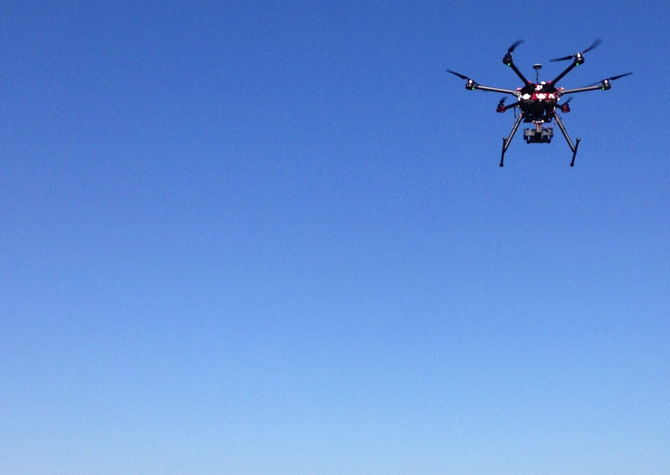
Unmanned Aerial Vehicle Imaging System Creation For Water Quality Analysis
Victoria Scholl
Advisor: Aaron Gerace
Committee: David Long, Carl Salvaggio

Slide 2
Outline
The Purpose
The Dream
The Team
The Progress
The Future

Slide 3
The Purpose
Notes:
Under the Clean Water Act, lists of impaired waters must be developed to identify waters that are too polluted to meet the water quality standards set by their states. The Rochester Embayment, primarily consisting of the region near where the Genesee River flows into the Lake Ontario Central Basin, is on the EPA’s impaired water list. Traditional remote sensing platforms have been used to monitor its water quality, but each has its serious limitations.

Slide 4
The Purpose
NASA Jet Propulsion Lab Airborne Visible InfraRed Imaging Spectrometer
+ spectral resolution (224 bands, 400-2500nm)
- temporal resolution (once in 1999)
Notes:
Rochester Embayment on EPA’s impaired waters list
Need for water quality and vegetation health analysis
Long-term, frequent monitoring desired
Existing satellites & airborne systems are not ideal (spatial / temporal resolution, collection pattern limitations)
Many other potential applications of system for CIS

Slide 5
The Purpose
NASA Jet Propulsion Lab Airborne Visible InfraRed Imaging Spectrometer
+ spectral resolution (224 bands, 400-2500nm)
- temporal resolution (once in 1999)
NASA Landsat 8 satellite
+ temporal resolution (every 16 days)
- spectral/spatial resolution (30m pixels)
- limited by presence of atmosphere & clouds
Notes:
Rochester Embayment on EPA’s impaired waters list
Need for water quality and vegetation health analysis
Long-term, frequent monitoring desired
Existing satellites & airborne systems are not ideal (spatial / temporal resolution, collection pattern limitations)
Many other potential applications of system for CIS

Slide 6
The Purpose
NASA Jet Propulsion Lab Airborne Visible InfraRed Imaging Spectrometer
+ spectral resolution (224 bands, 400-2500nm)
- temporal resolution (once in 1999)
NASA Landsat 8 satellite
+ temporal resolution (every 16 days)
- spectral/spatial resolution (30m pixels)
- limited by presence of atmosphere & clouds
Multispectral UAV Imaging System
+ temporal resolution (whenever we want)
- spectral (any filters we want) /spatial resolution (1 inch pixels)
+ minimal atmosphere at low altitudes
Notes:
Rochester Embayment on EPA’s impaired waters list
Need for water quality and vegetation health analysis
Long-term, frequent monitoring desired
Existing satellites & airborne systems are not ideal (spatial / temporal resolution, collection pattern limitations)
Many other potential applications of system for CIS

Slide 7
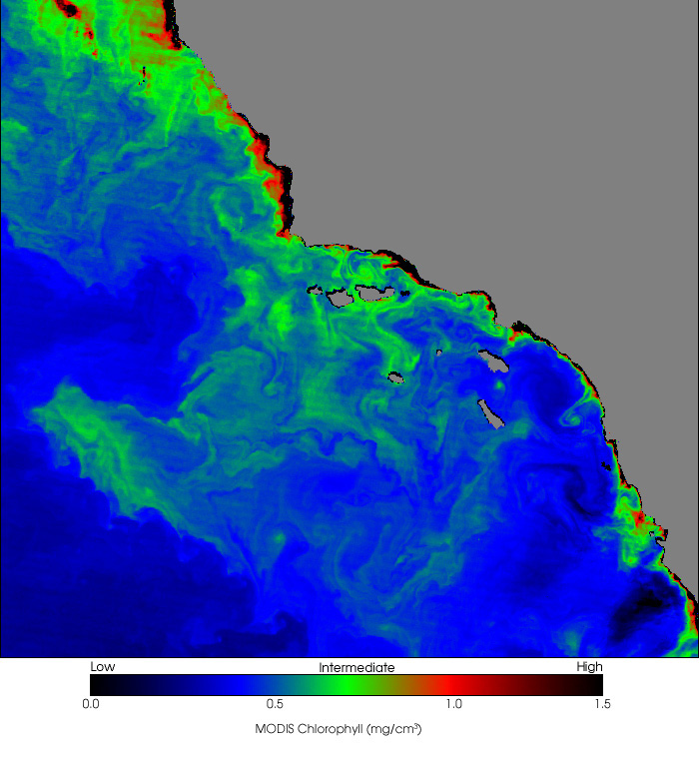
The Dream
Fully functioning system and capture workflow
Develop calibration protocol
Image transfer, conversion, stitching
Near real-time, in-water constituent mapping

Slide 8
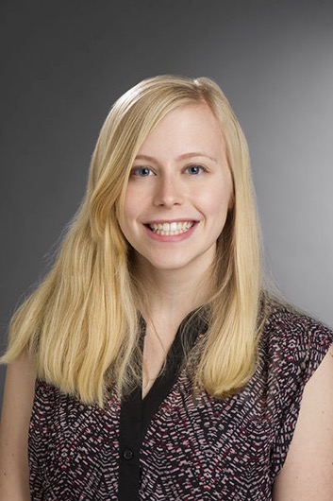
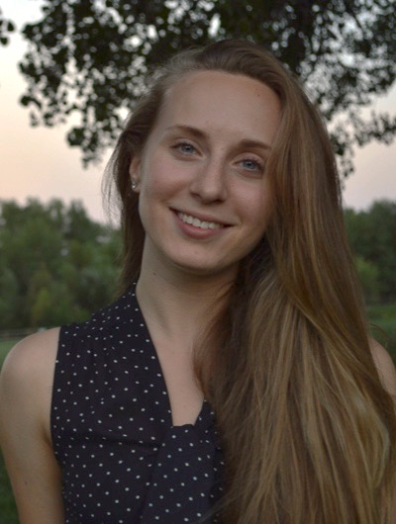
The Team
Students
Liz Bondi (Land) & myself (Water)

Slide 9
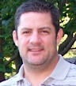
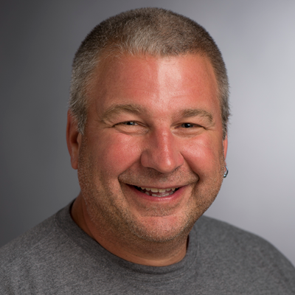
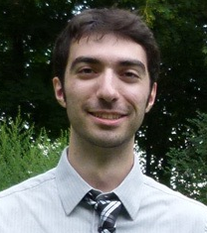
The Team
Students
Liz Bondi (Land) & myself (Water)
Research Experience
Aaron Gerace, CIS
Carl Salvaggio, CIS
Matt Montanero, NASA

Slide 10
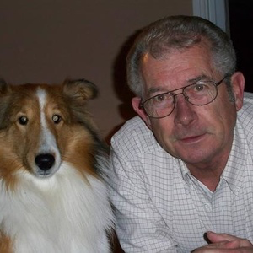
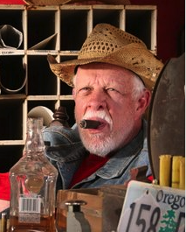
The Team
Students
Liz Bondi (Land) & myself (Water)
Research Experience
Aaron Gerace, CIS
Carl Salvaggio, CIS
Matt Montanero, NASA
Drone ownership & operation
Zeke Hurd and Mickey
PJ (Papa Jeff Ring)
Notes:
Zeke is hoping to start a business with the system, and Papa Jeff.
Liz is responsible for vegetation health efforts (primarily metrics such as NDVI), while I am working with the water imagery (constituent mapping).

Slide 11
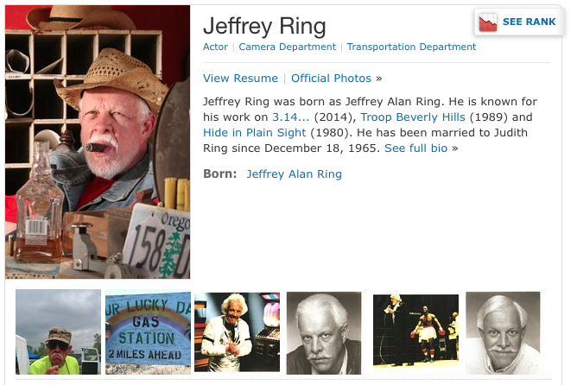
The Team

Slide 12
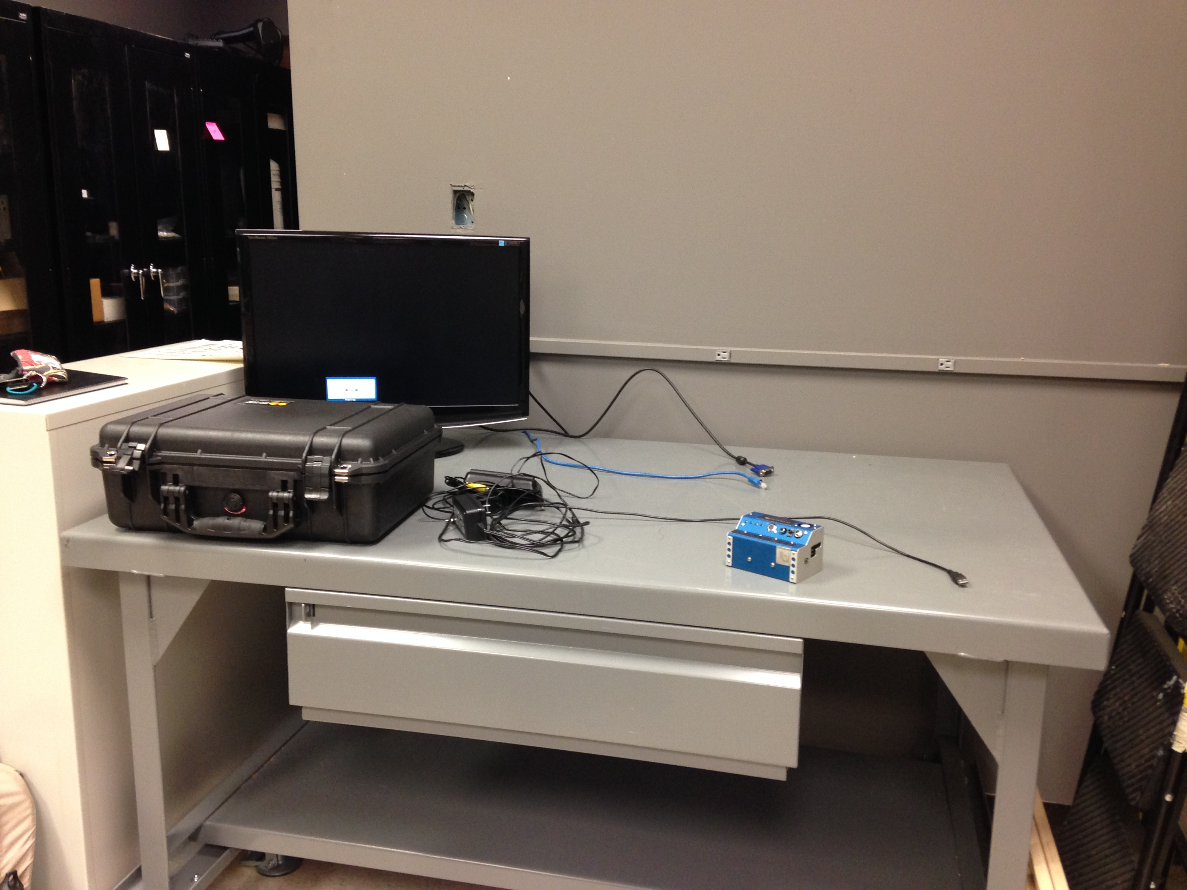
The Progress
Over the summer:
Wrote funding proposal. CIS MicroGrant awarded ($5000)
Band selection analysis started over the summer
Camera acquired, complications with initial testing

Slide 13
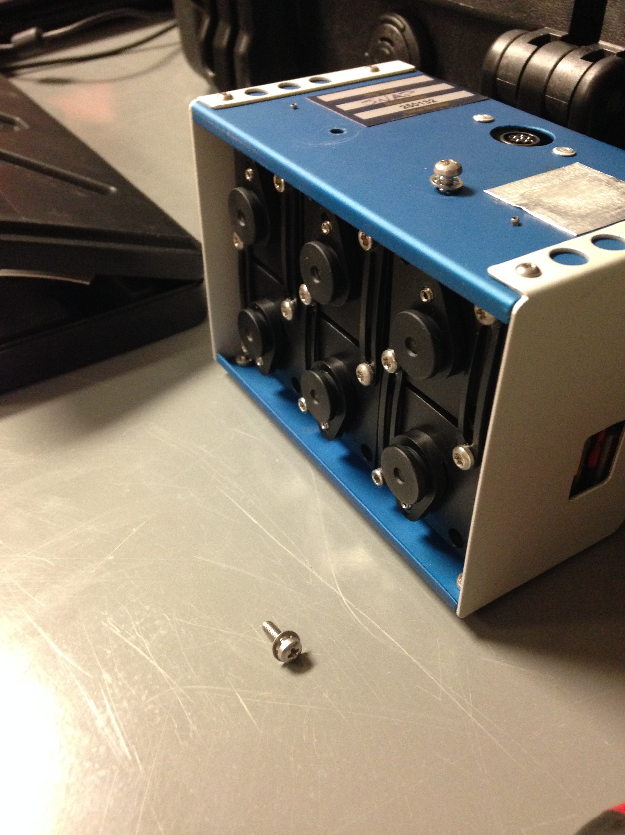
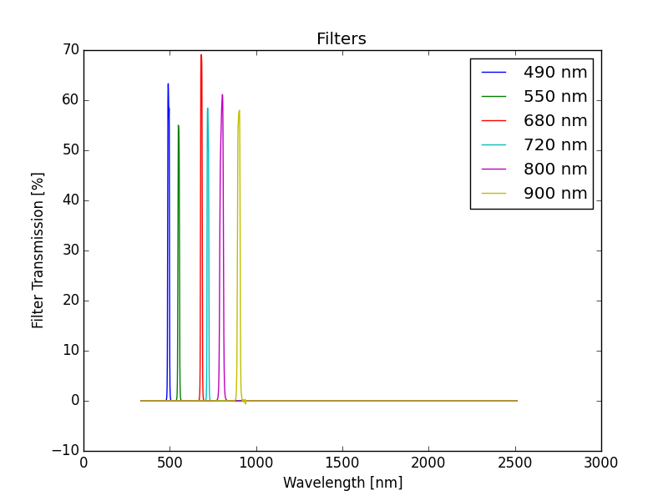
The Progress
Tetracam Micro Multi-Camera Array Snap ($20,000)
6 compact, synchronized digital cameras
16GB memory card per camera
1.3 megapixel CMOS sensors (1280x1024), 10-bit DC
Each bandpass filter ($1,300)
1 master (set exposure time and geo-referencing), 5 slaves (set relative to master)
PixelWrench2 software for image transfer and processing requires Windows 8
Focal Length: 9.6mm
Global shutter

Slide 14
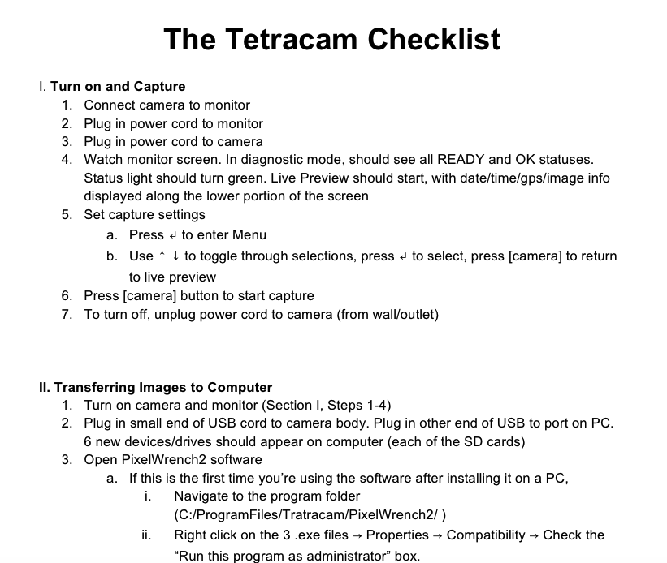
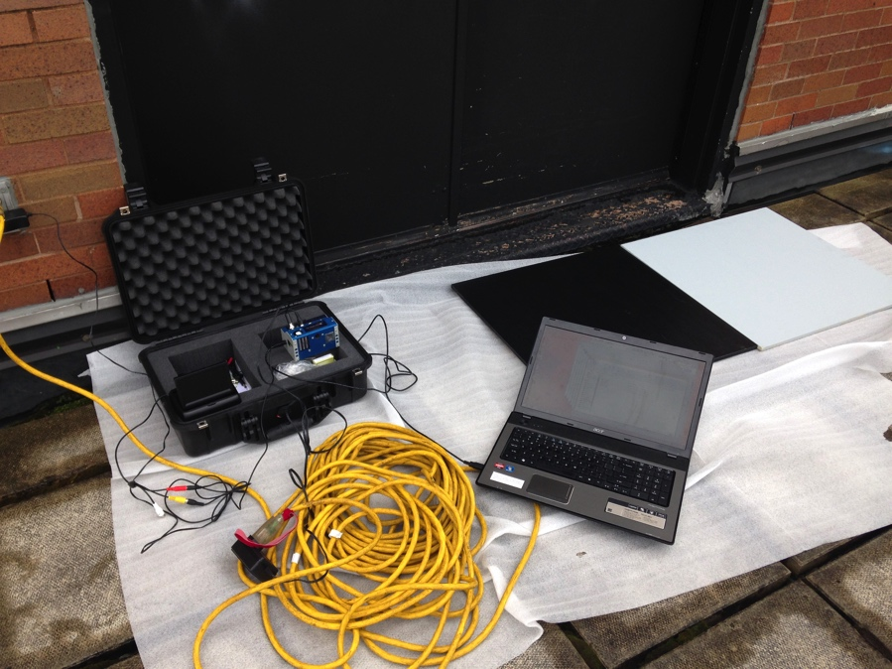
The Progress
Documenting how to use the Tetracam:
Gain, exposure time, format, capture mode

Slide 15
The Progress
Calibration
To use the imagery for scientific purposes, we have to equate digital count to a quantity of interest: reflectance

Slide 16
The Progress
Calibration
To use the imagery for scientific purposes, we have to equate digital count to a quantity of interest: reflectance
ELM (Empirical Line Method)
Interpolate between dark and light targets of known reflectance
Reflectance %
Pixel DC

Slide 17
The Progress
Calibration
To use the imagery for scientific purposes, we have to equate digital count to a quantity of interest: reflectance
ELM (Empirical Line Method)
Interpolate between dark and light targets of known reflectance
Reflectance %
Pixel DC

Slide 18
The Progress
Shaded
Sunlit
0%
16%
60%

Slide 19
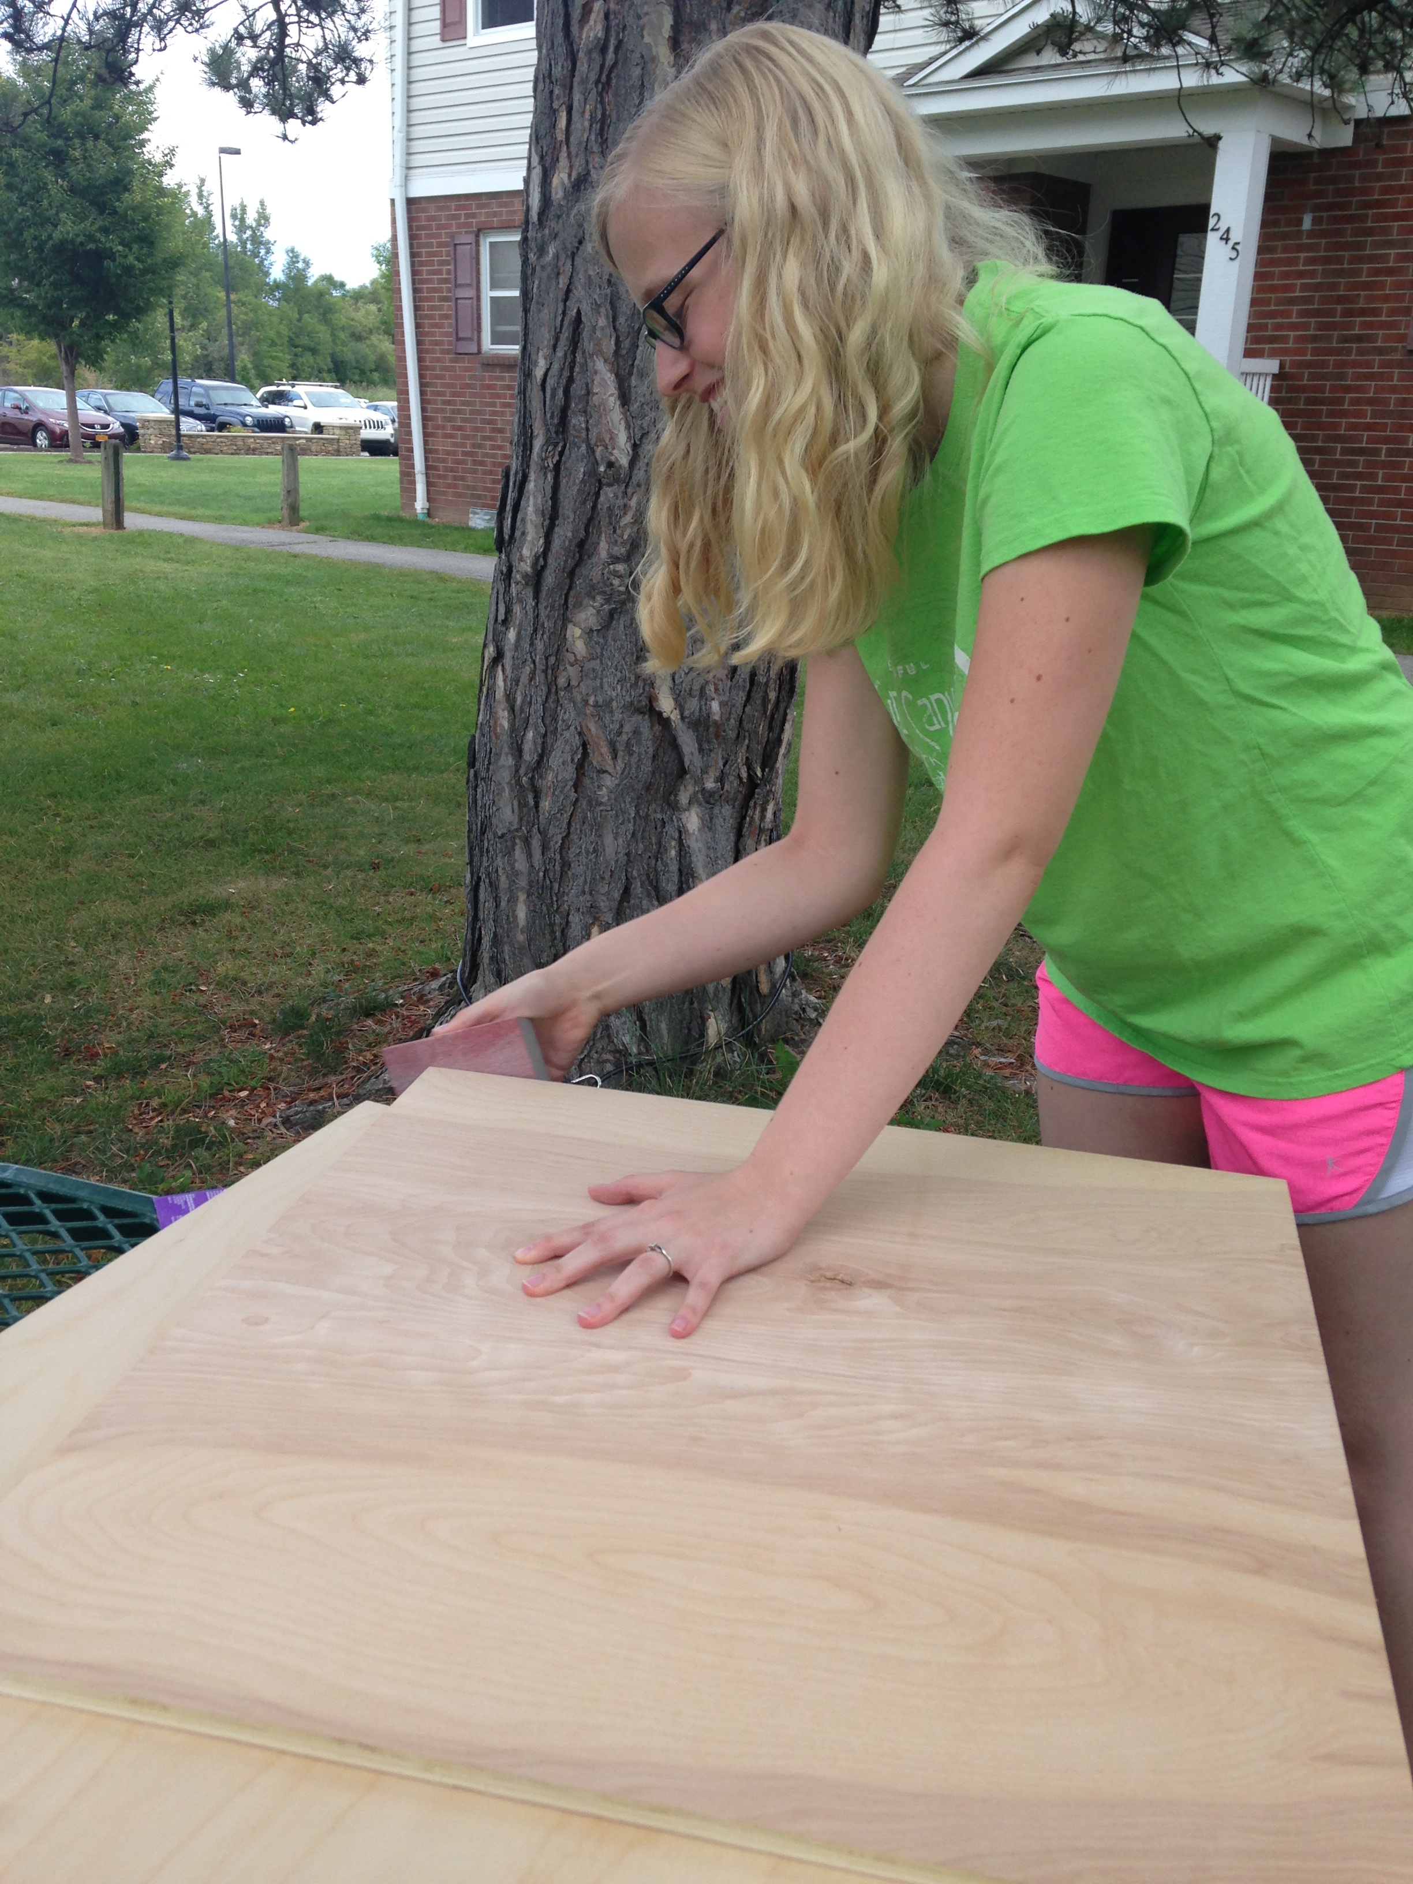
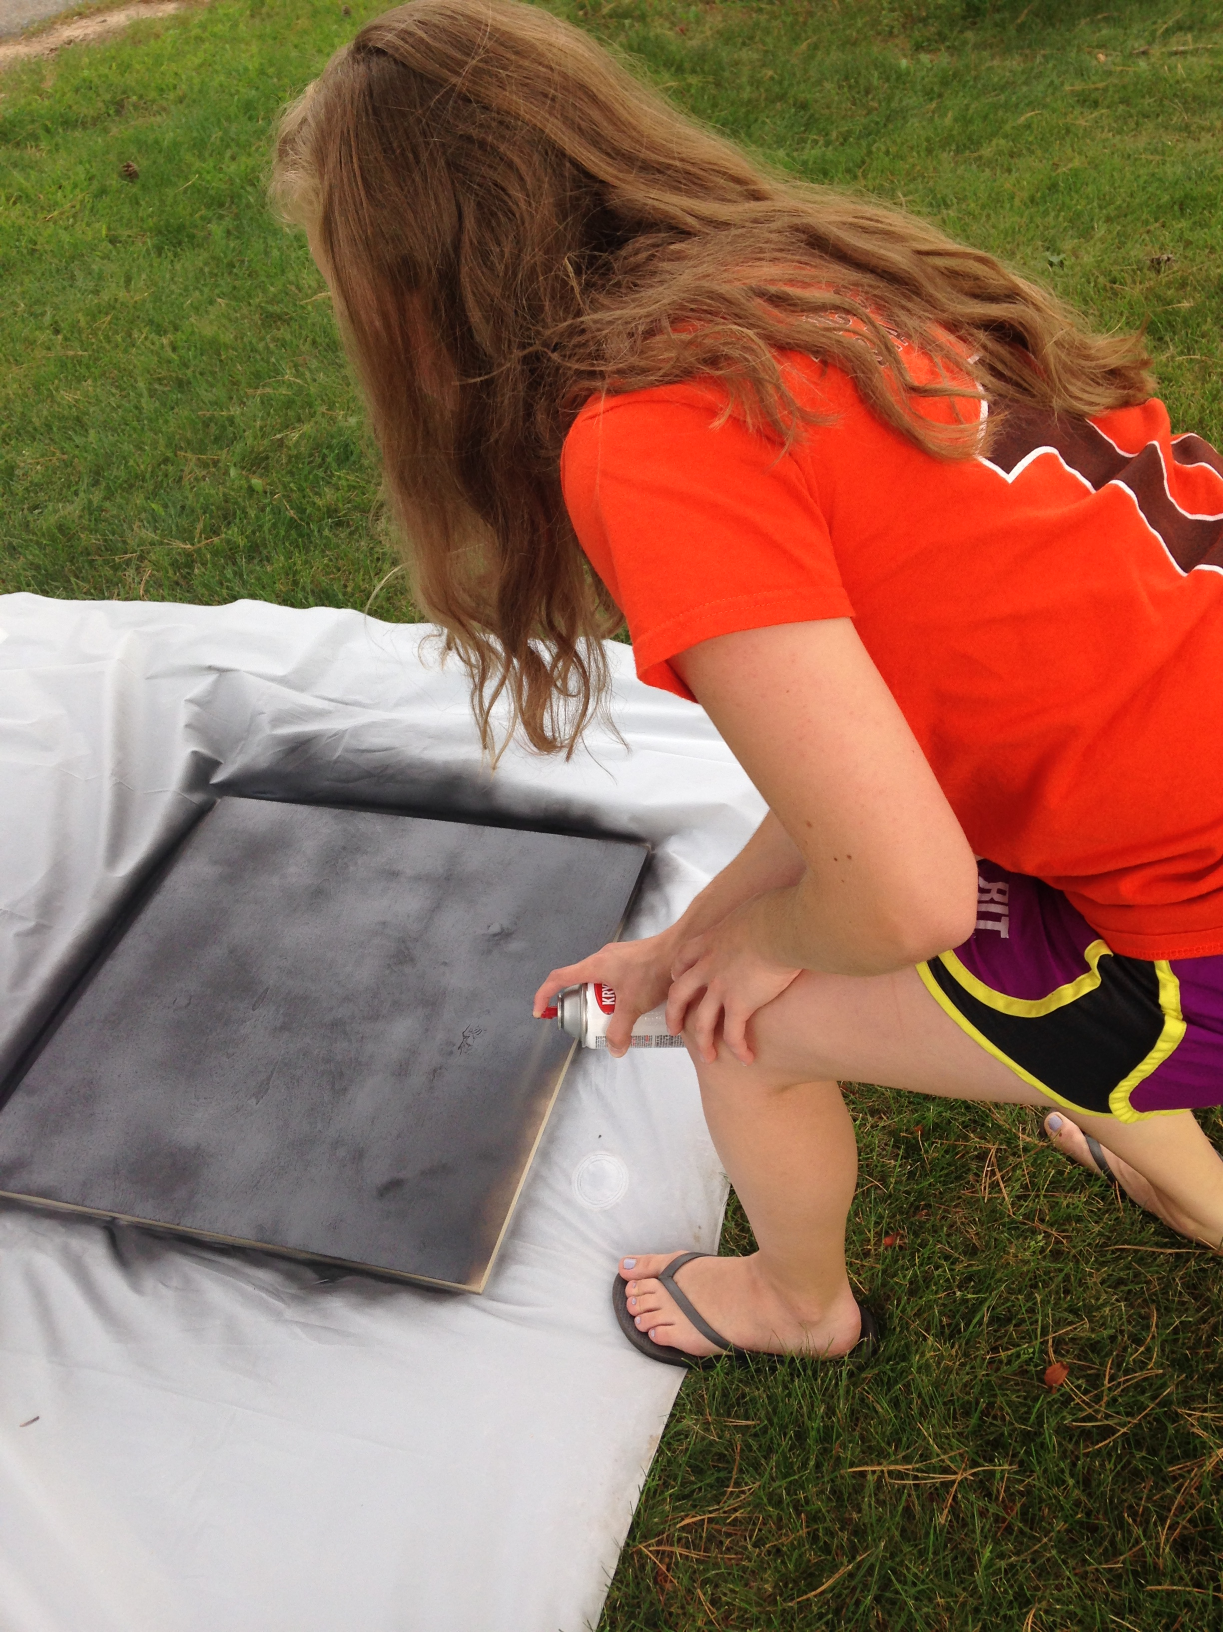
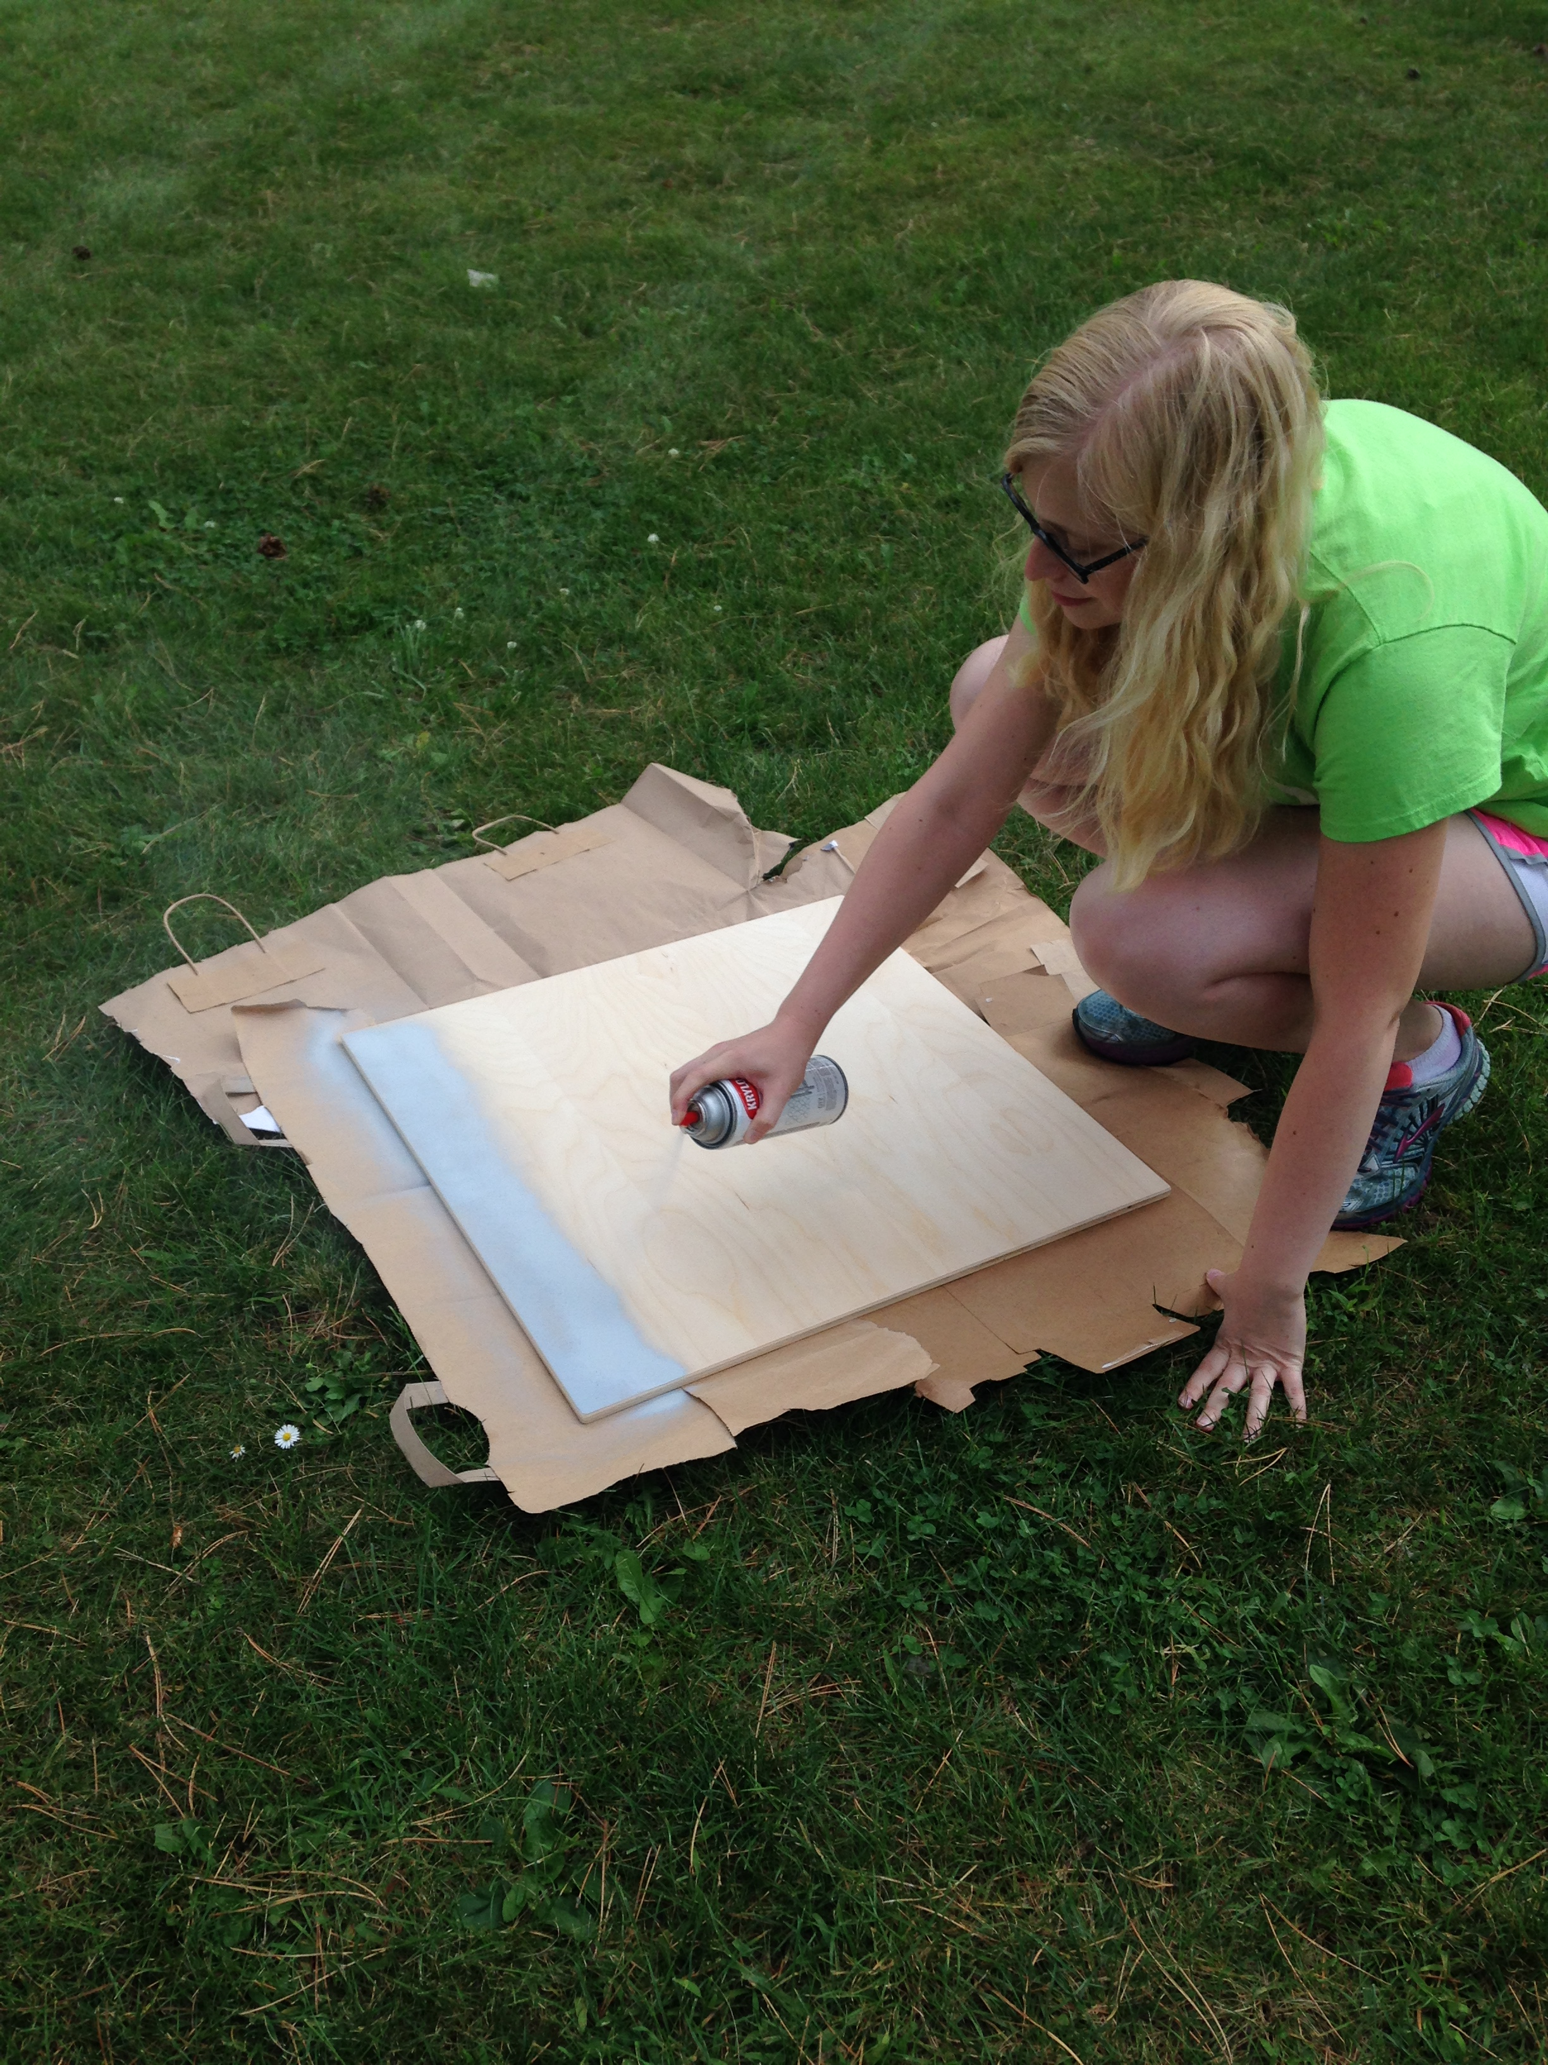
The Progress
Calibration Target Paint Reflectance
Light, Land: 60%
Light, Water: 16%
Dark: 0%
Notes:
One of my tasks during the early weeks of this semester was to create the targets of known reflectance for calibration.
This involved calculating how large they need to be (which was determined to be 2x2’ for a flight altitude of 200ft), buying wood and getting it cut to the appropriate size, and finding the right paint. The paint should be spectrally flat, meaning it reflects equally at all wavelengths (at least the visible and NIR, which is what the Tetracam is sensitive to). Krylon makes an “ultra flat” black spray paint that is perfect but finding a lighter gray proved to be challenging.
We want different “light” grays for each application (water vs. veg) based on the maximum reflectance of each subject of interest. We tested out a variety of different paints and measured their spectral reflectance with an SVC spectometer.

Slide 20
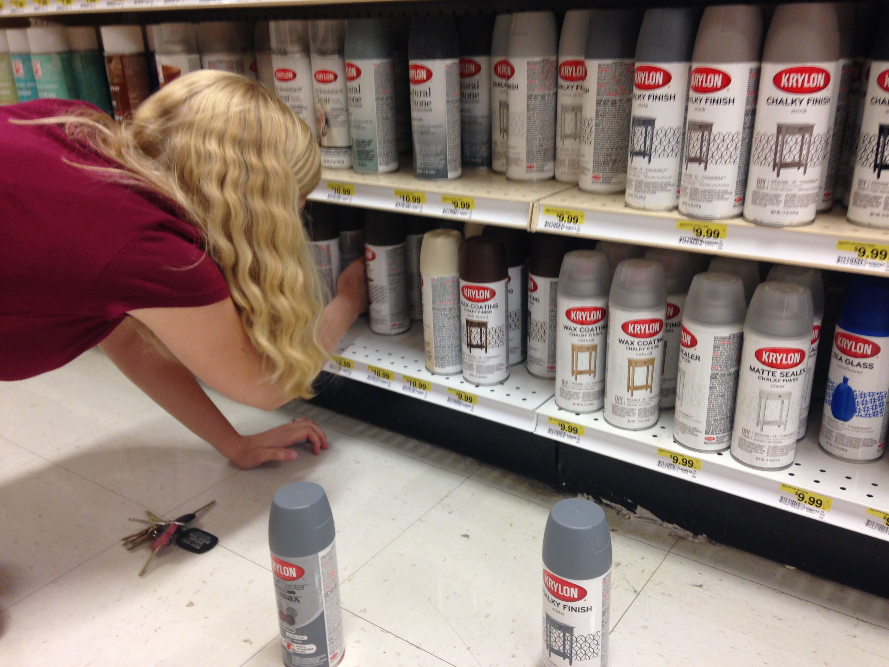
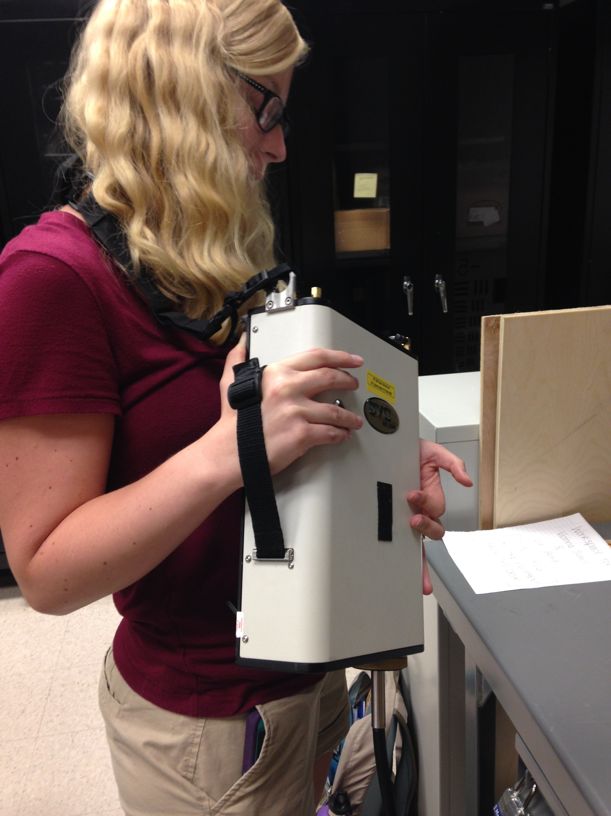
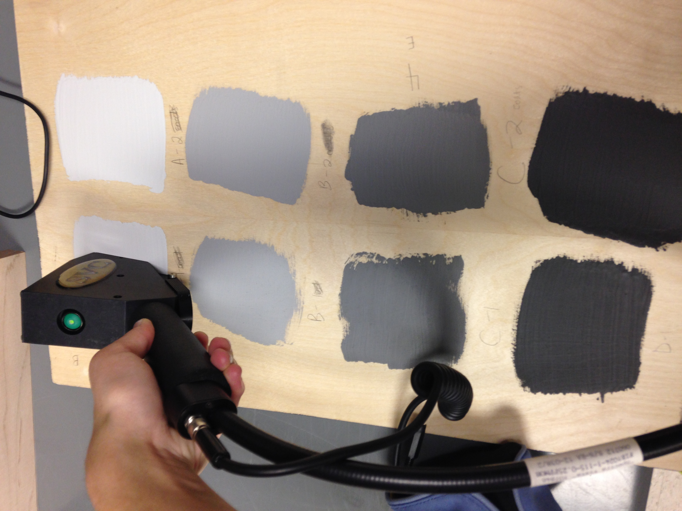
The Progress
Calibration Target Paint Reflectance
Light, Land: 60%
Light, Water: 16%
Dark: 0%
Notes:
One of my tasks during the early weeks of this semester was to create the targets of known reflectance for calibration.
This involved calculating how large they need to be (which was determined to be 2x2’ for a flight altitude of 200ft), buying wood and getting it cut to the appropriate size, and finding the right paint. The paint should be spectrally flat, meaning it reflects equally at all wavelengths (at least the visible and NIR, which is what the Tetracam is sensitive to). Krylon makes an “ultra flat” black spray paint that is perfect but finding a lighter gray proved to be challenging.
We want different “light” grays for each application (water vs. veg) based on the maximum reflectance of each subject of interest. We tested out a variety of different paints and measured their spectral reflectance with an SVC spectometer.

Slide 21
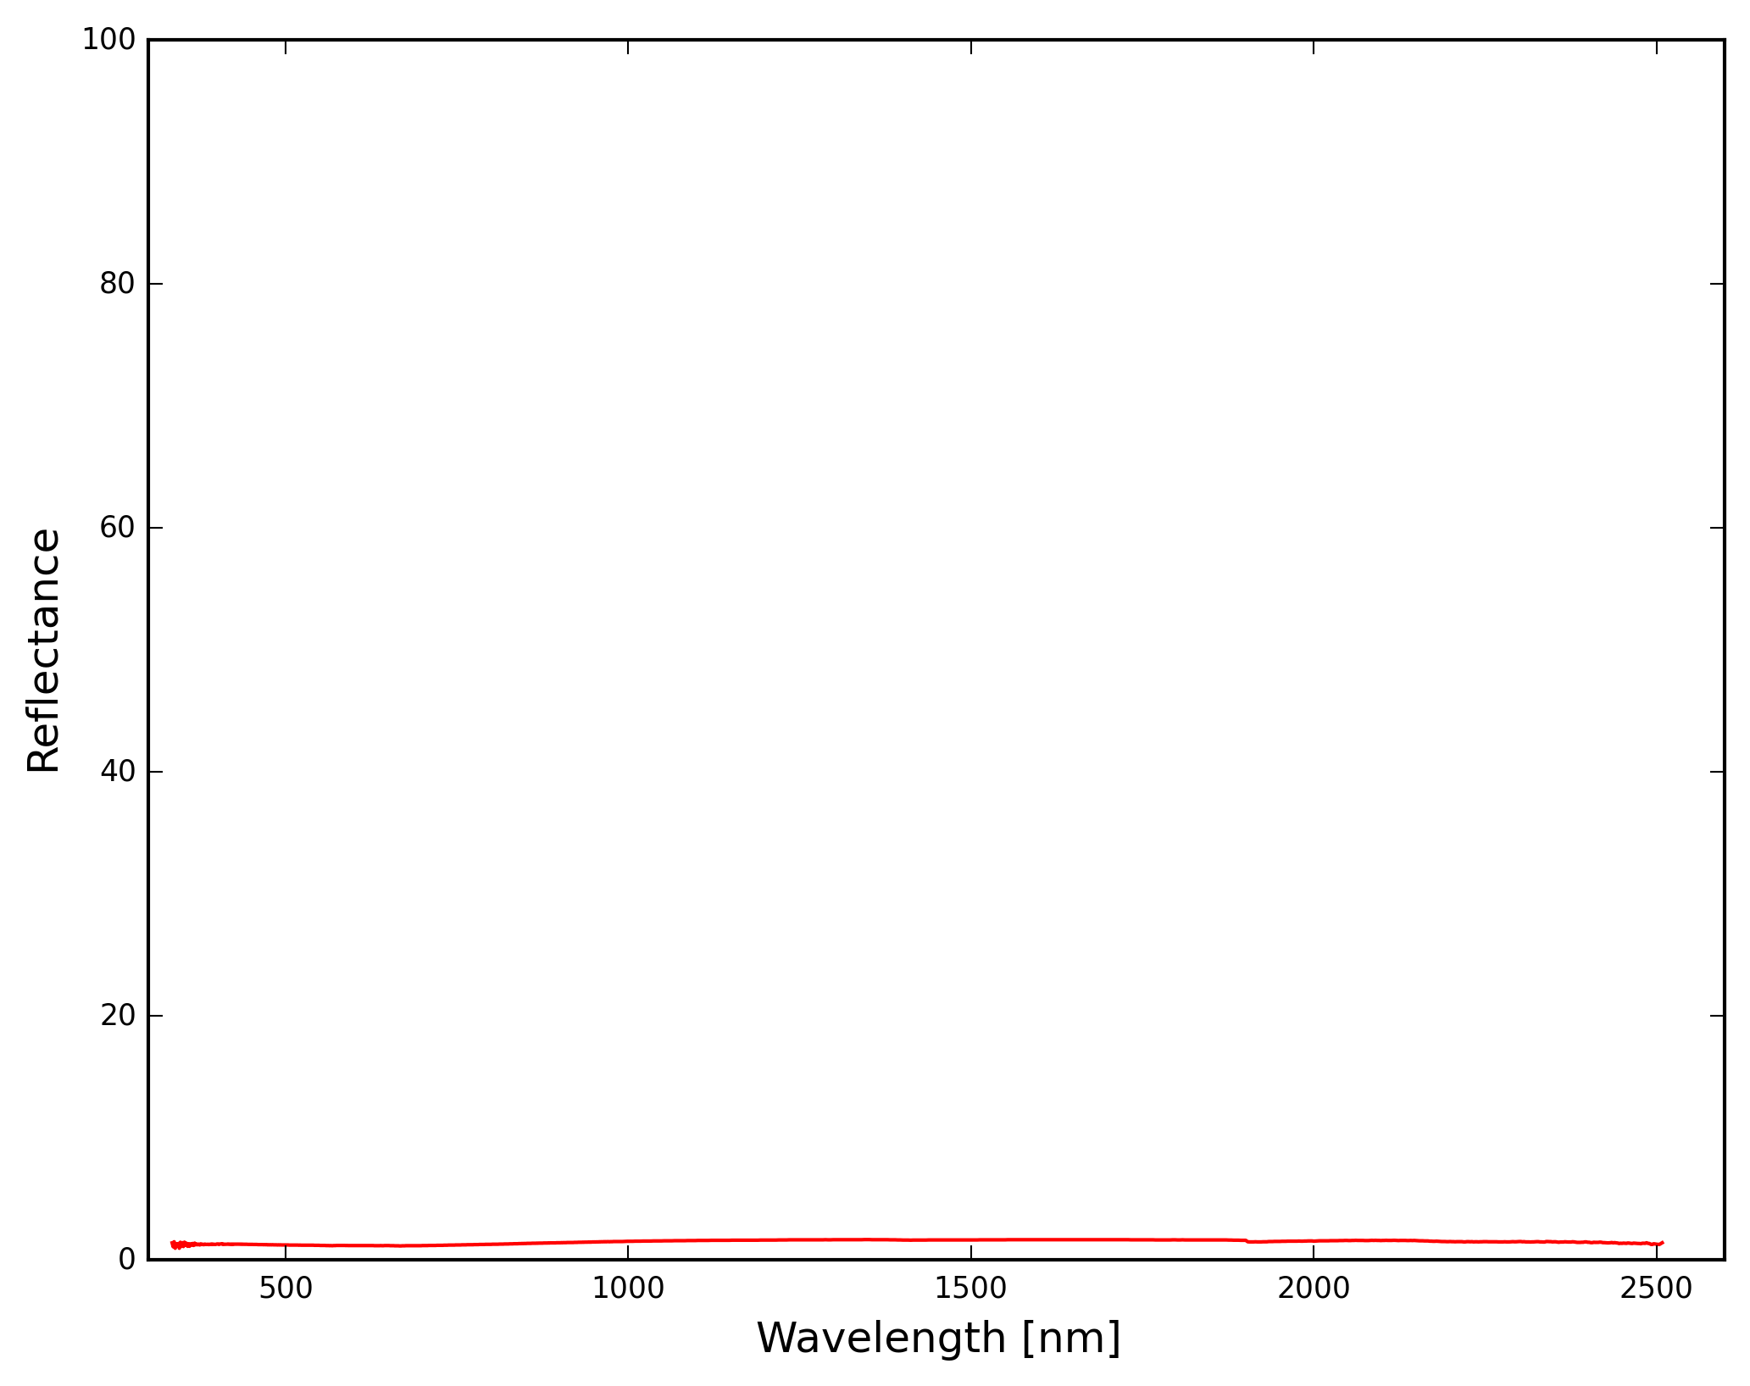
The Progress
Calibration Target Paint Reflectance
Light, Land: 60%
Light, Water: 16%
Dark: 0%
Notes:
One of my tasks during the early weeks of this semester was to create the targets of known reflectance for calibration.
This involved calculating how large they need to be (which was determined to be 2x2’ for a flight altitude of 200ft), buying wood and getting it cut to the appropriate size, and finding the right paint. The paint should be spectrally flat, meaning it reflects equally at all wavelengths (at least the visible and NIR, which is what the Tetracam is sensitive to). Krylon makes an “ultra flat” black spray paint that is perfect but finding a lighter gray proved to be challenging.
We want different “light” grays for each application (water vs. veg) based on the maximum reflectance of each subject of interest. We tested out a variety of different paints and measured their spectral reflectance with an SVC spectometer.

Slide 22
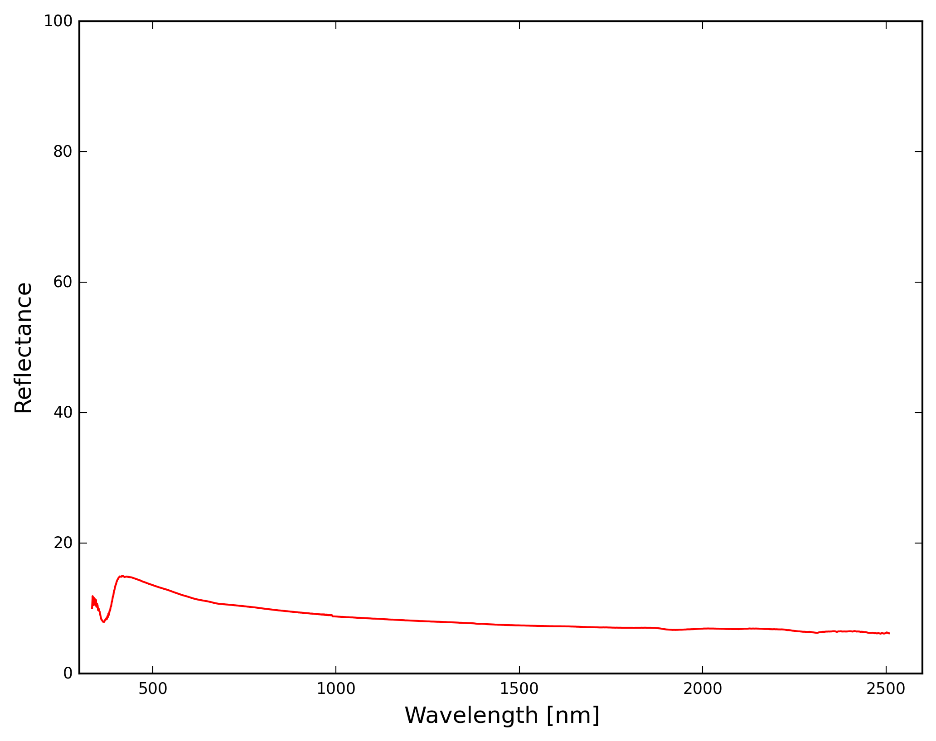
The Progress
Calibration Target Paint Reflectance
Light, Land: 60%
Light, Water: 16%
Dark: 0%
Notes:
One of my tasks during the early weeks of this semester was to create the targets of known reflectance for calibration.
This involved calculating how large they need to be (which was determined to be 2x2’ for a flight altitude of 200ft), buying wood and getting it cut to the appropriate size, and finding the right paint. The paint should be spectrally flat, meaning it reflects equally at all wavelengths (at least the visible and NIR, which is what the Tetracam is sensitive to). Krylon makes an “ultra flat” black spray paint that is perfect but finding a lighter gray proved to be challenging.
We want different “light” grays for each application (water vs. veg) based on the maximum reflectance of each subject of interest. We tested out a variety of different paints and measured their spectral reflectance with an SVC spectometer.

Slide 23
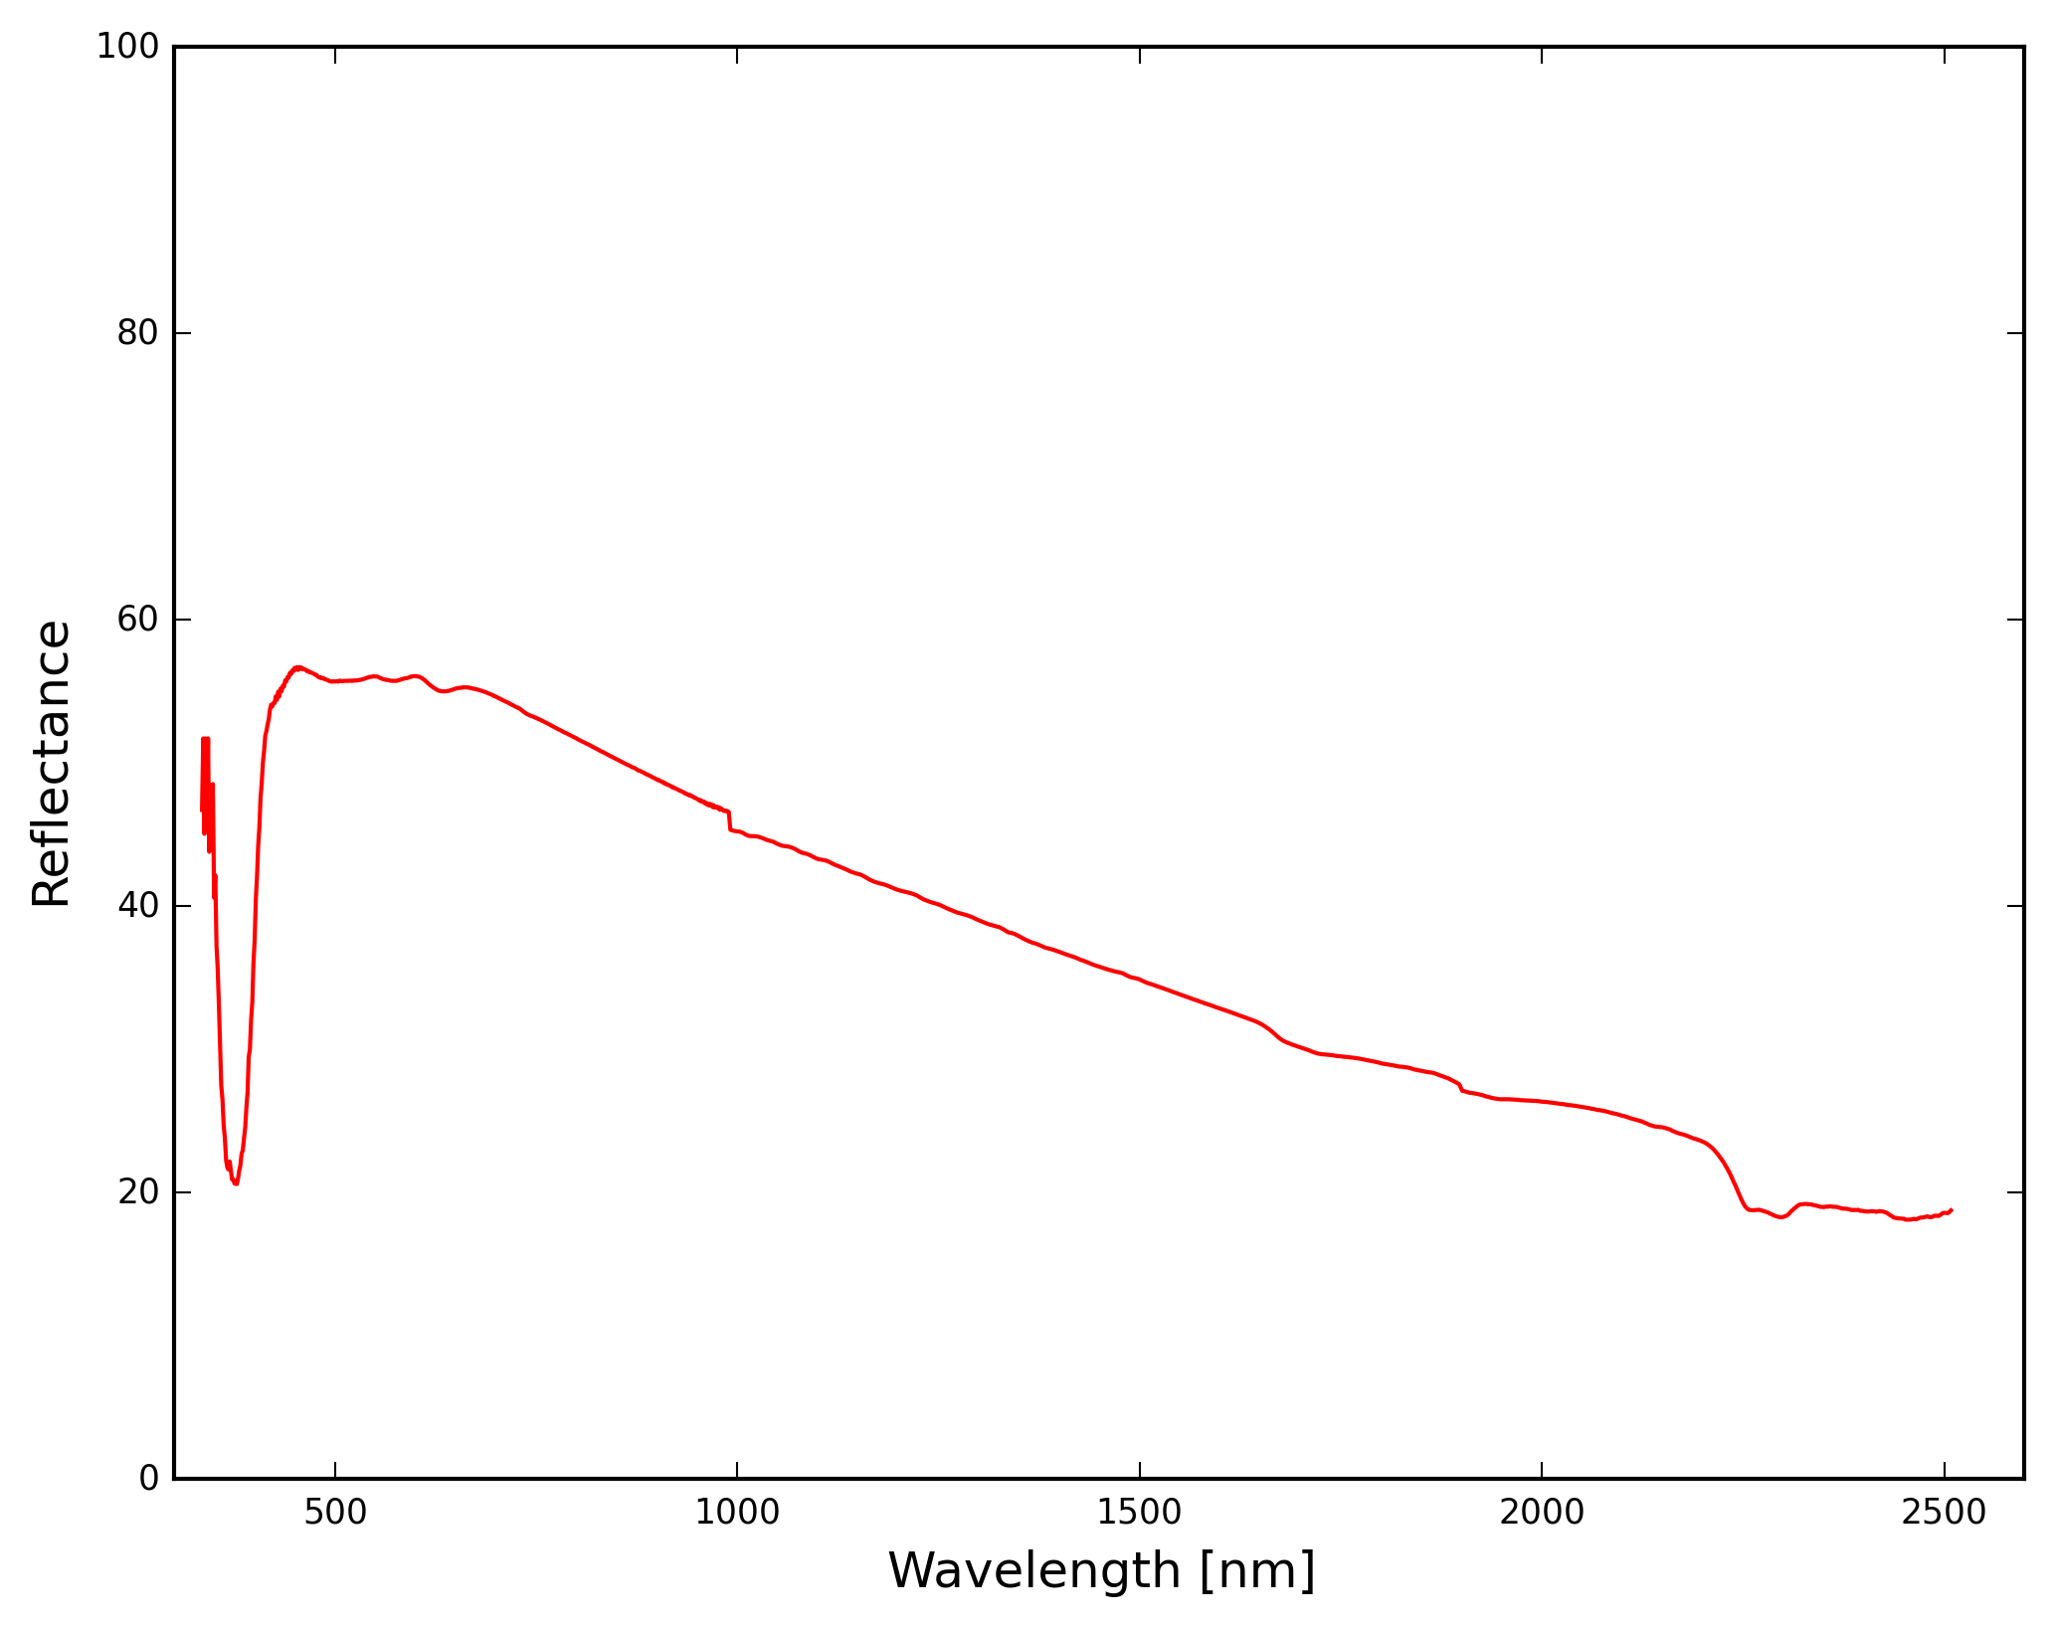
The Progress
Calibration Target Paint Reflectance
Light, Land: 60%
Light, Water: 16%
Dark: 0%
Notes:
One of my tasks during the early weeks of this semester was to create the targets of known reflectance for calibration.
This involved calculating how large they need to be (which was determined to be 2x2’ for a flight altitude of 200ft), buying wood and getting it cut to the appropriate size, and finding the right paint. The paint should be spectrally flat, meaning it reflects equally at all wavelengths (at least the visible and NIR, which is what the Tetracam is sensitive to). Krylon makes an “ultra flat” black spray paint that is perfect but finding a lighter gray proved to be challenging.
We want different “light” grays for each application (water vs. veg) based on the maximum reflectance of each subject of interest. We tested out a variety of different paints and measured their spectral reflectance with an SVC spectometer.

Slide 24
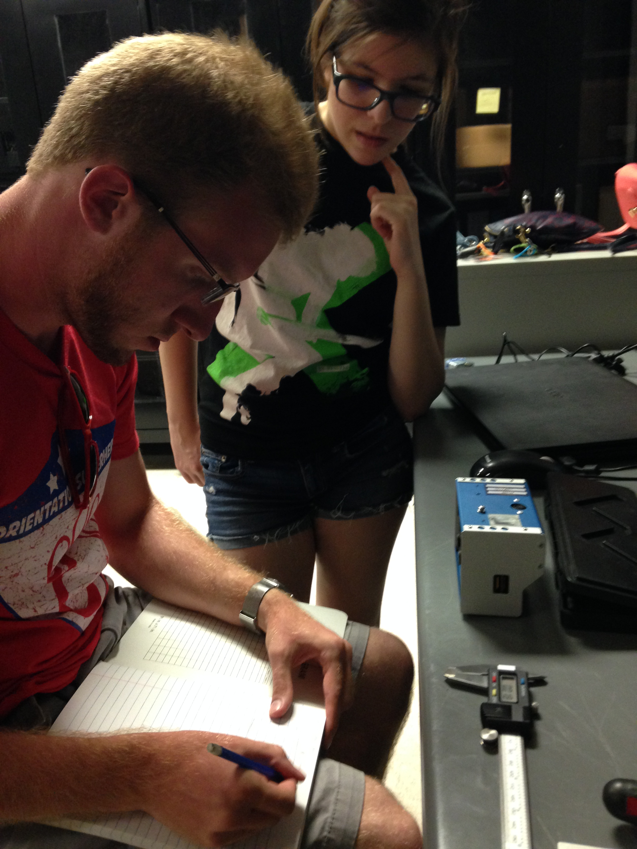
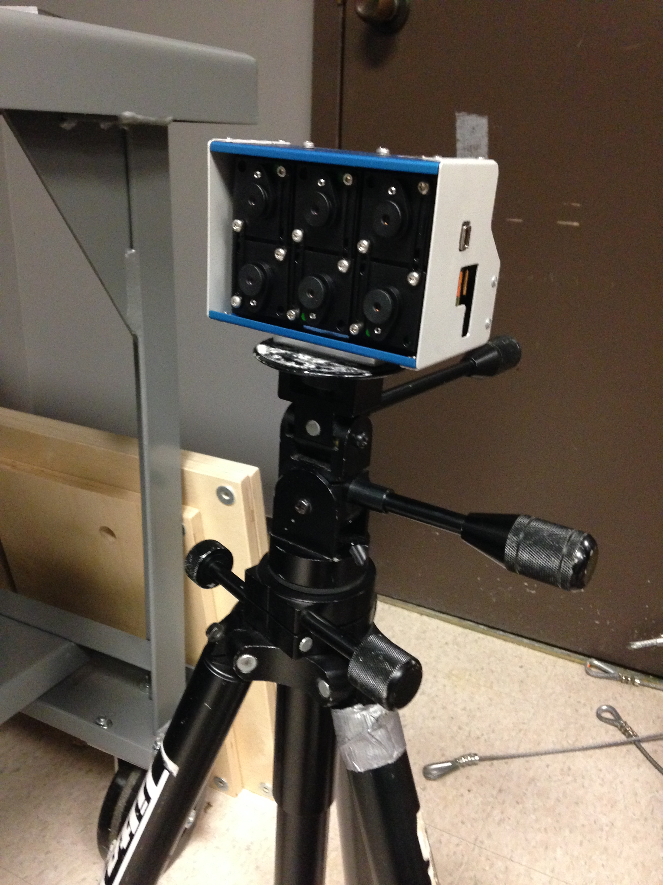
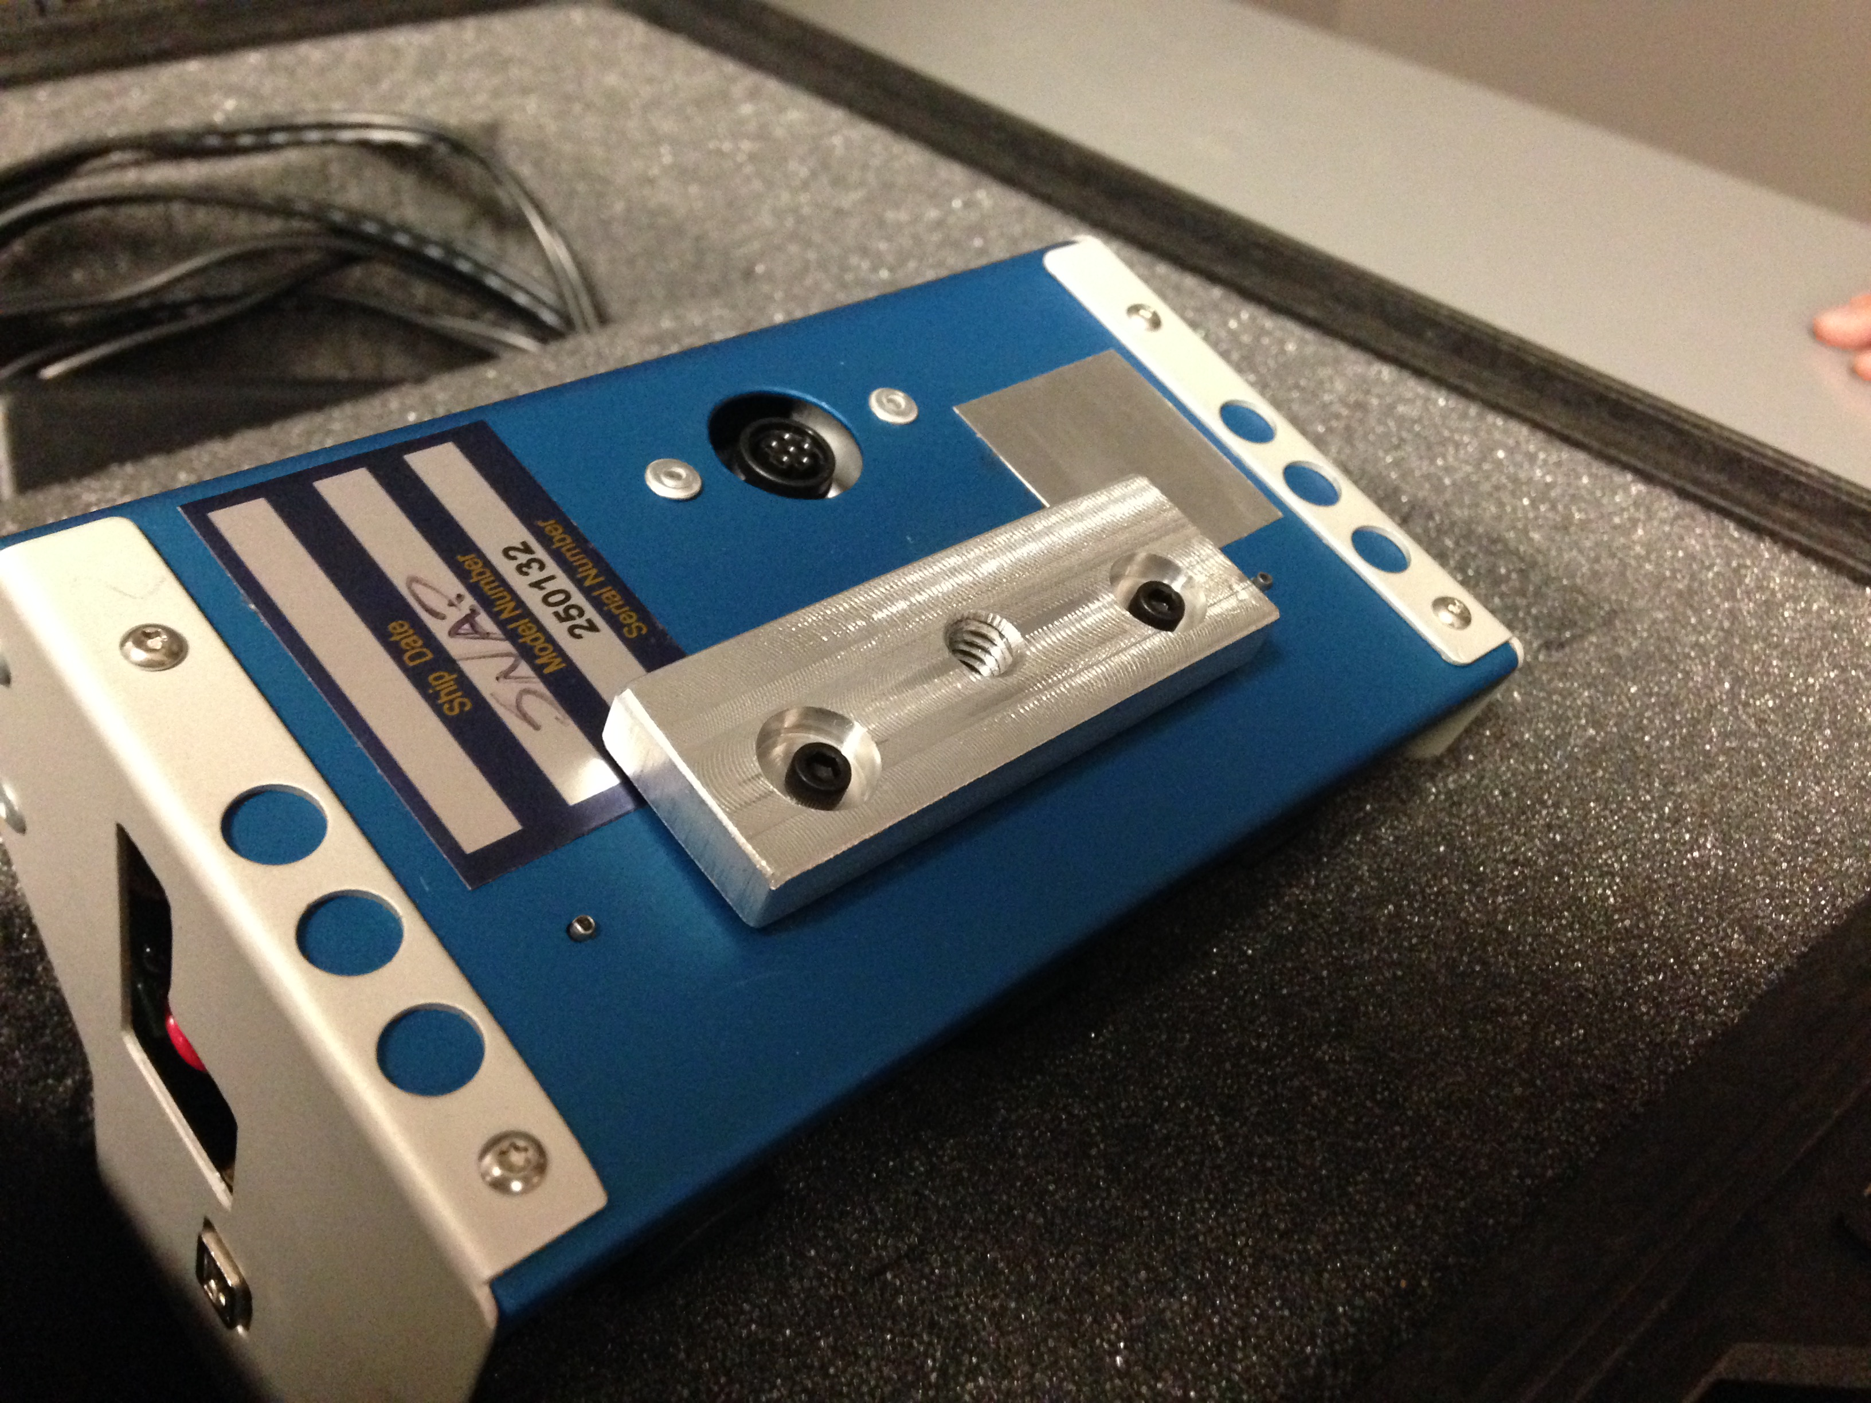
The Progress
Hardware prep
Tetracam tripod mount

Slide 25
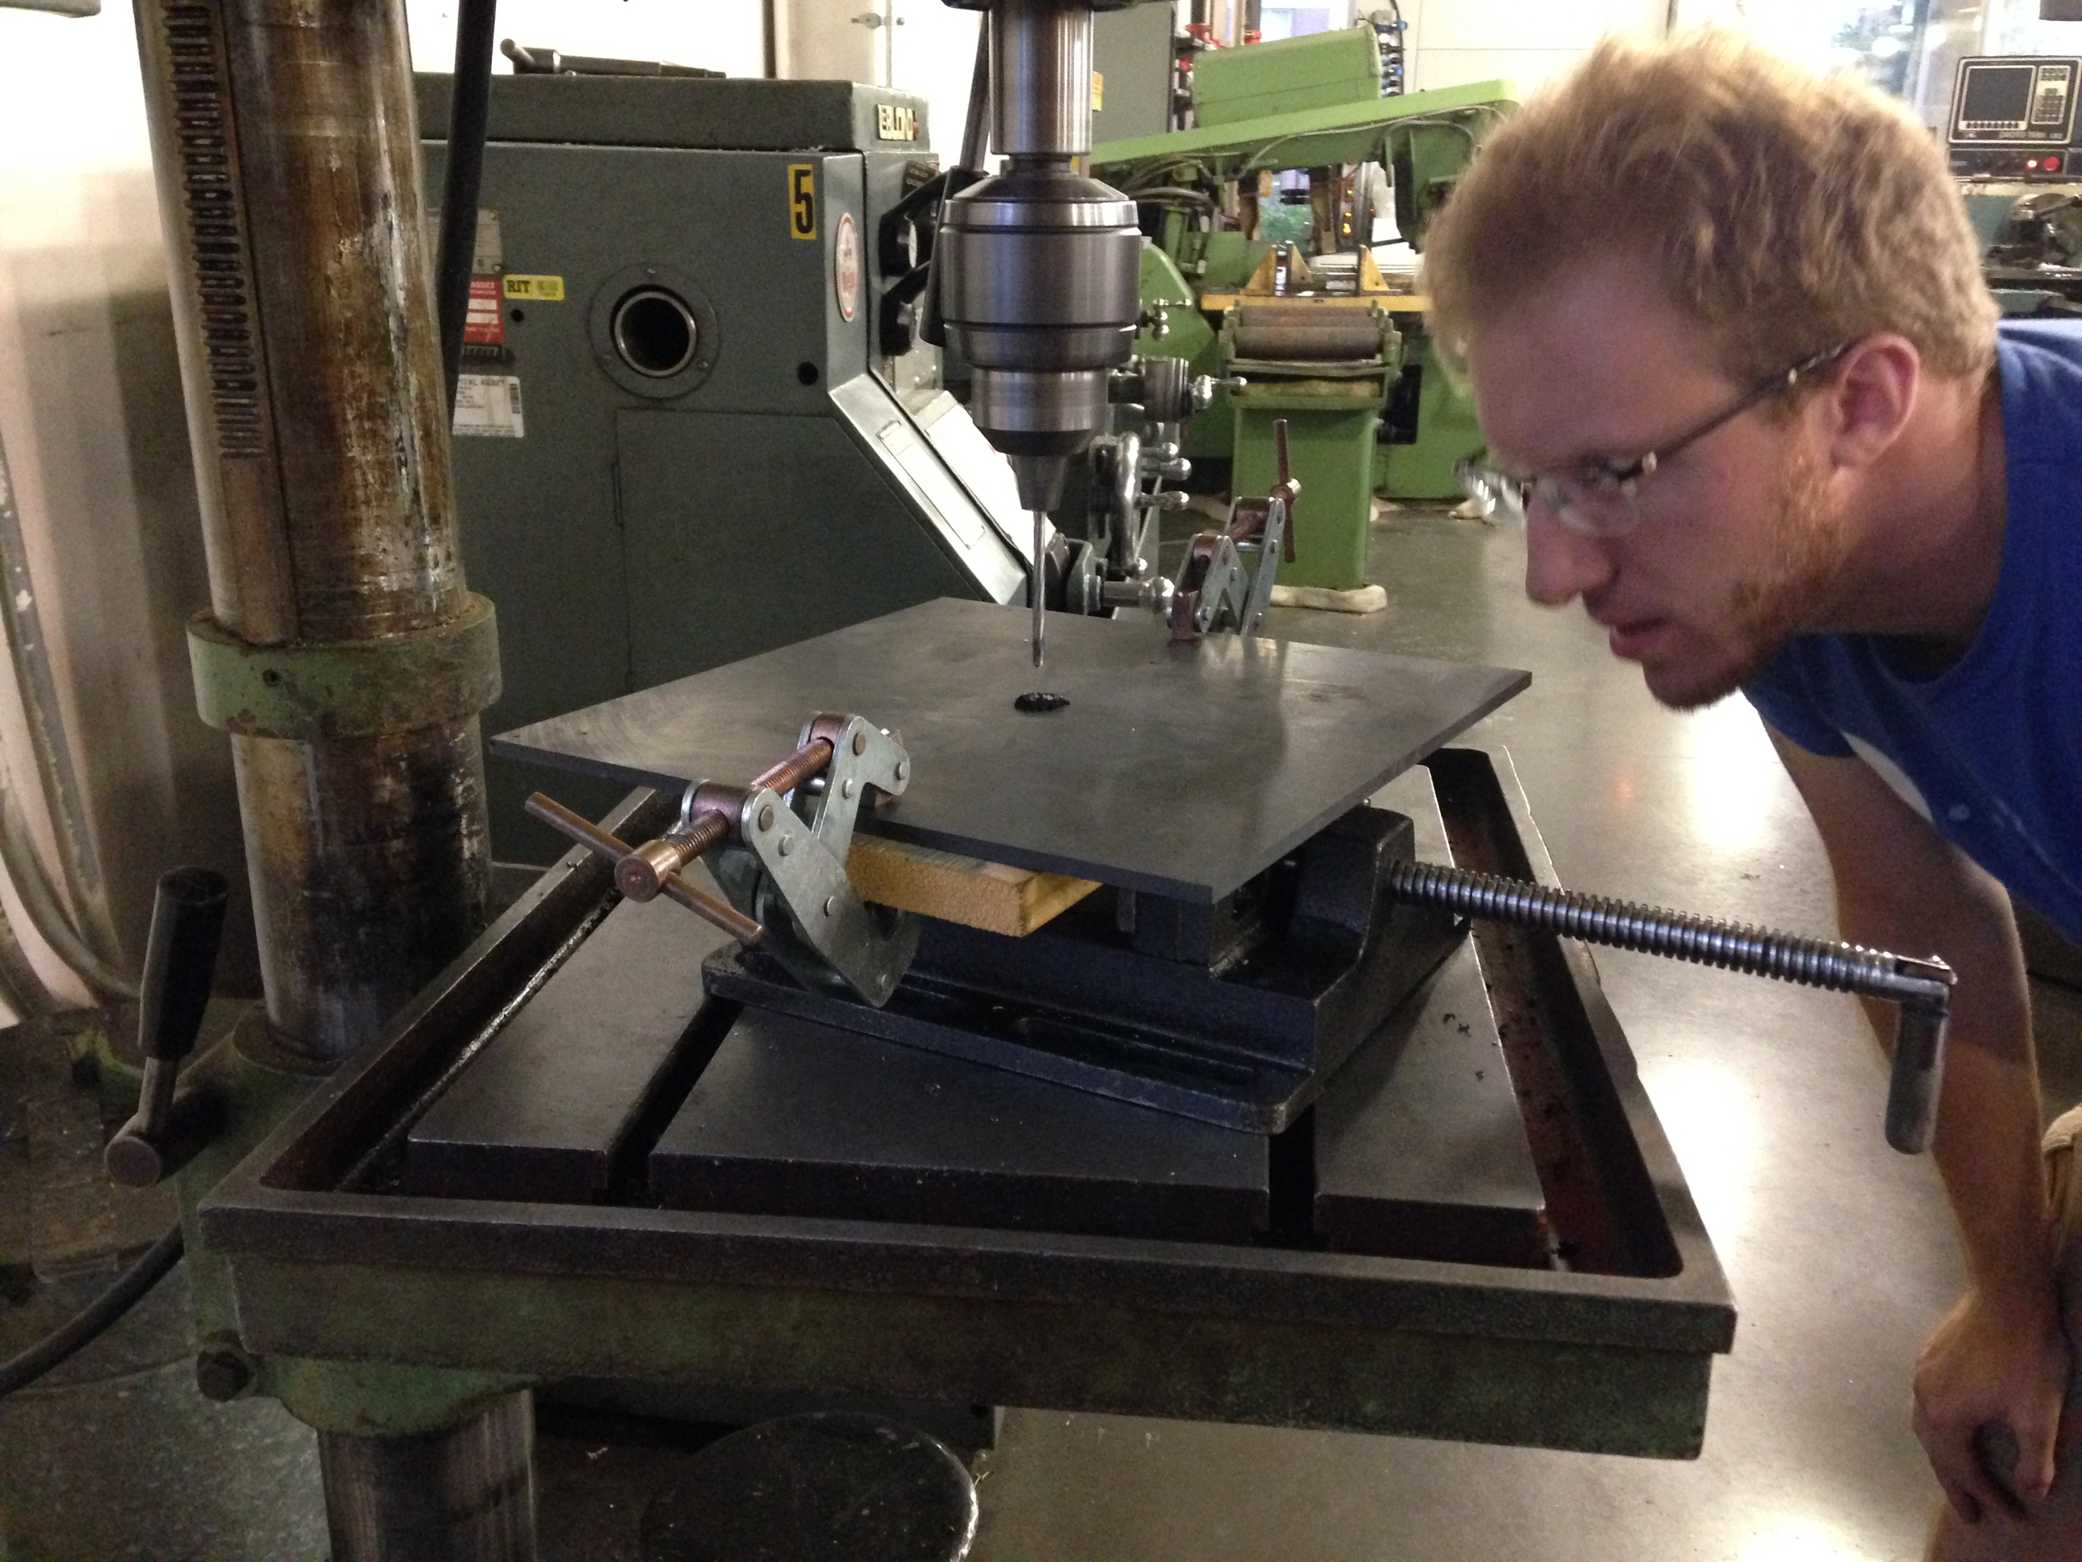
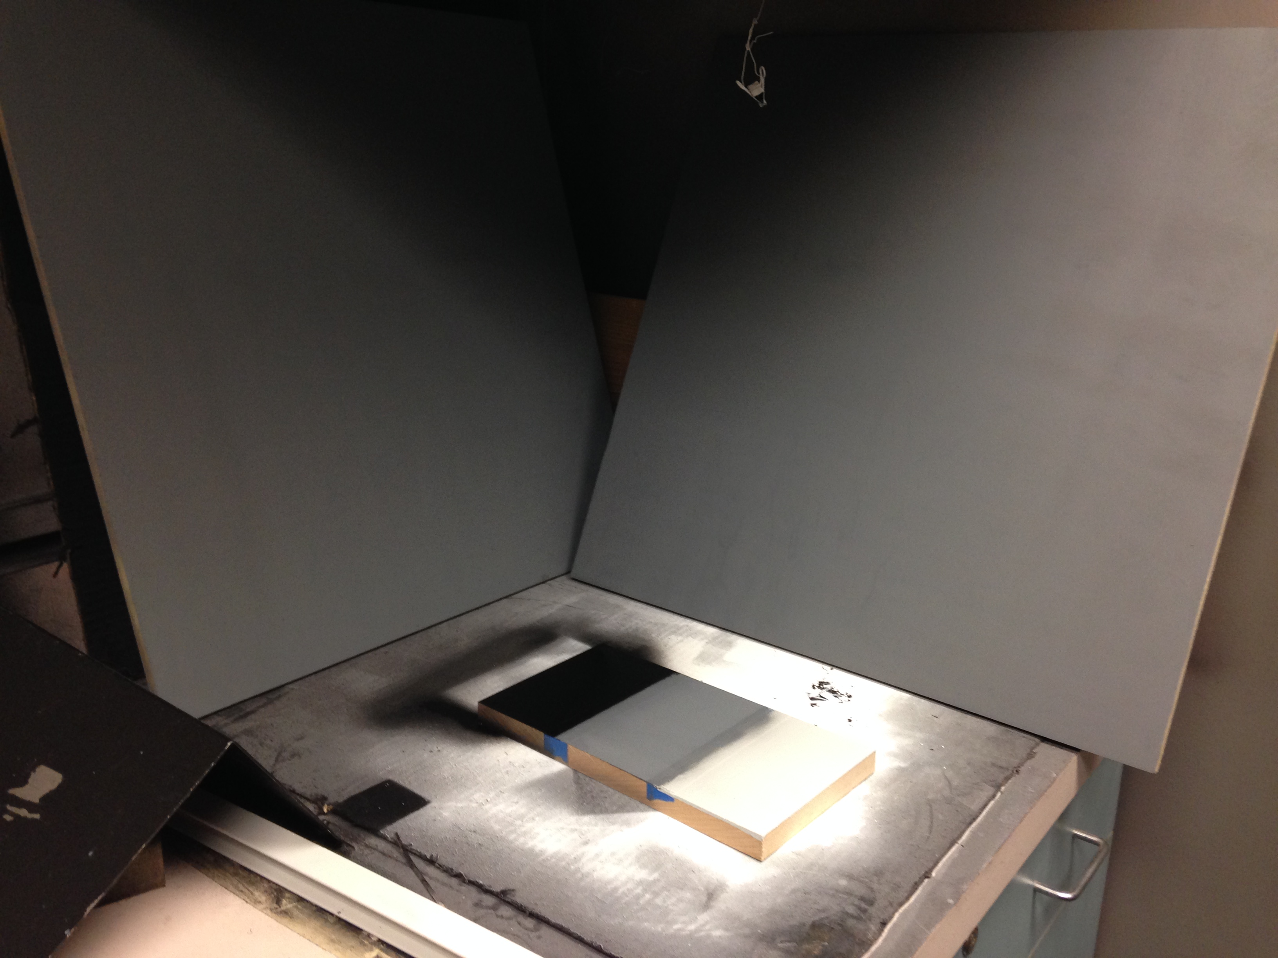
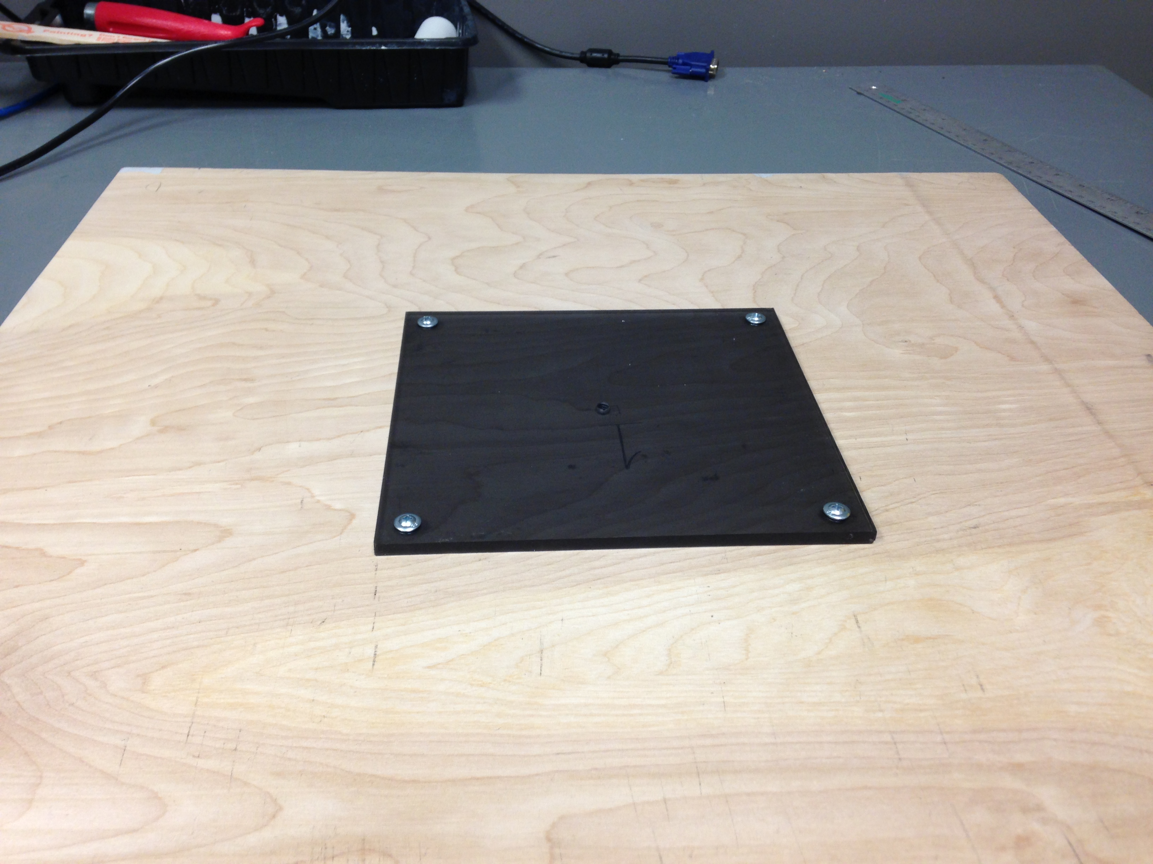
The Progress
Hardware prep
6 wooden calibration targets, painted, with tripod mounts
Exposure target

Slide 26
The Progress
Protocol for setting exposure
Need to manually set exposure time (microseconds)
Auto-exposure means imagery is not scientifically meaningful

Slide 27
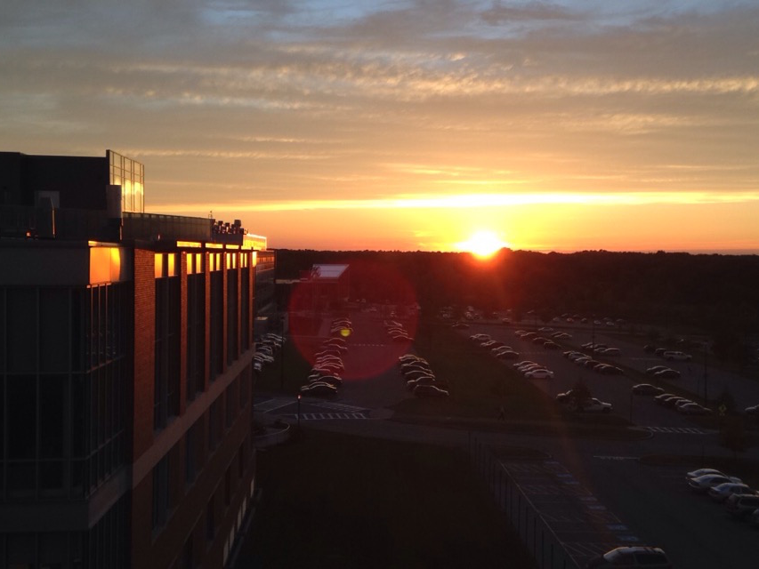
The Progress

Slide 28
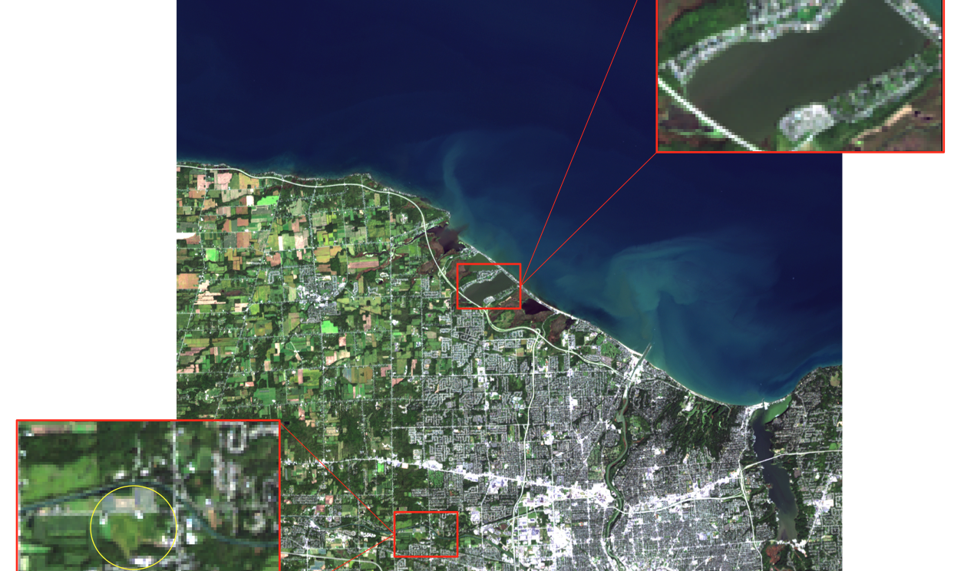
The Progress
Test Sites

Slide 29
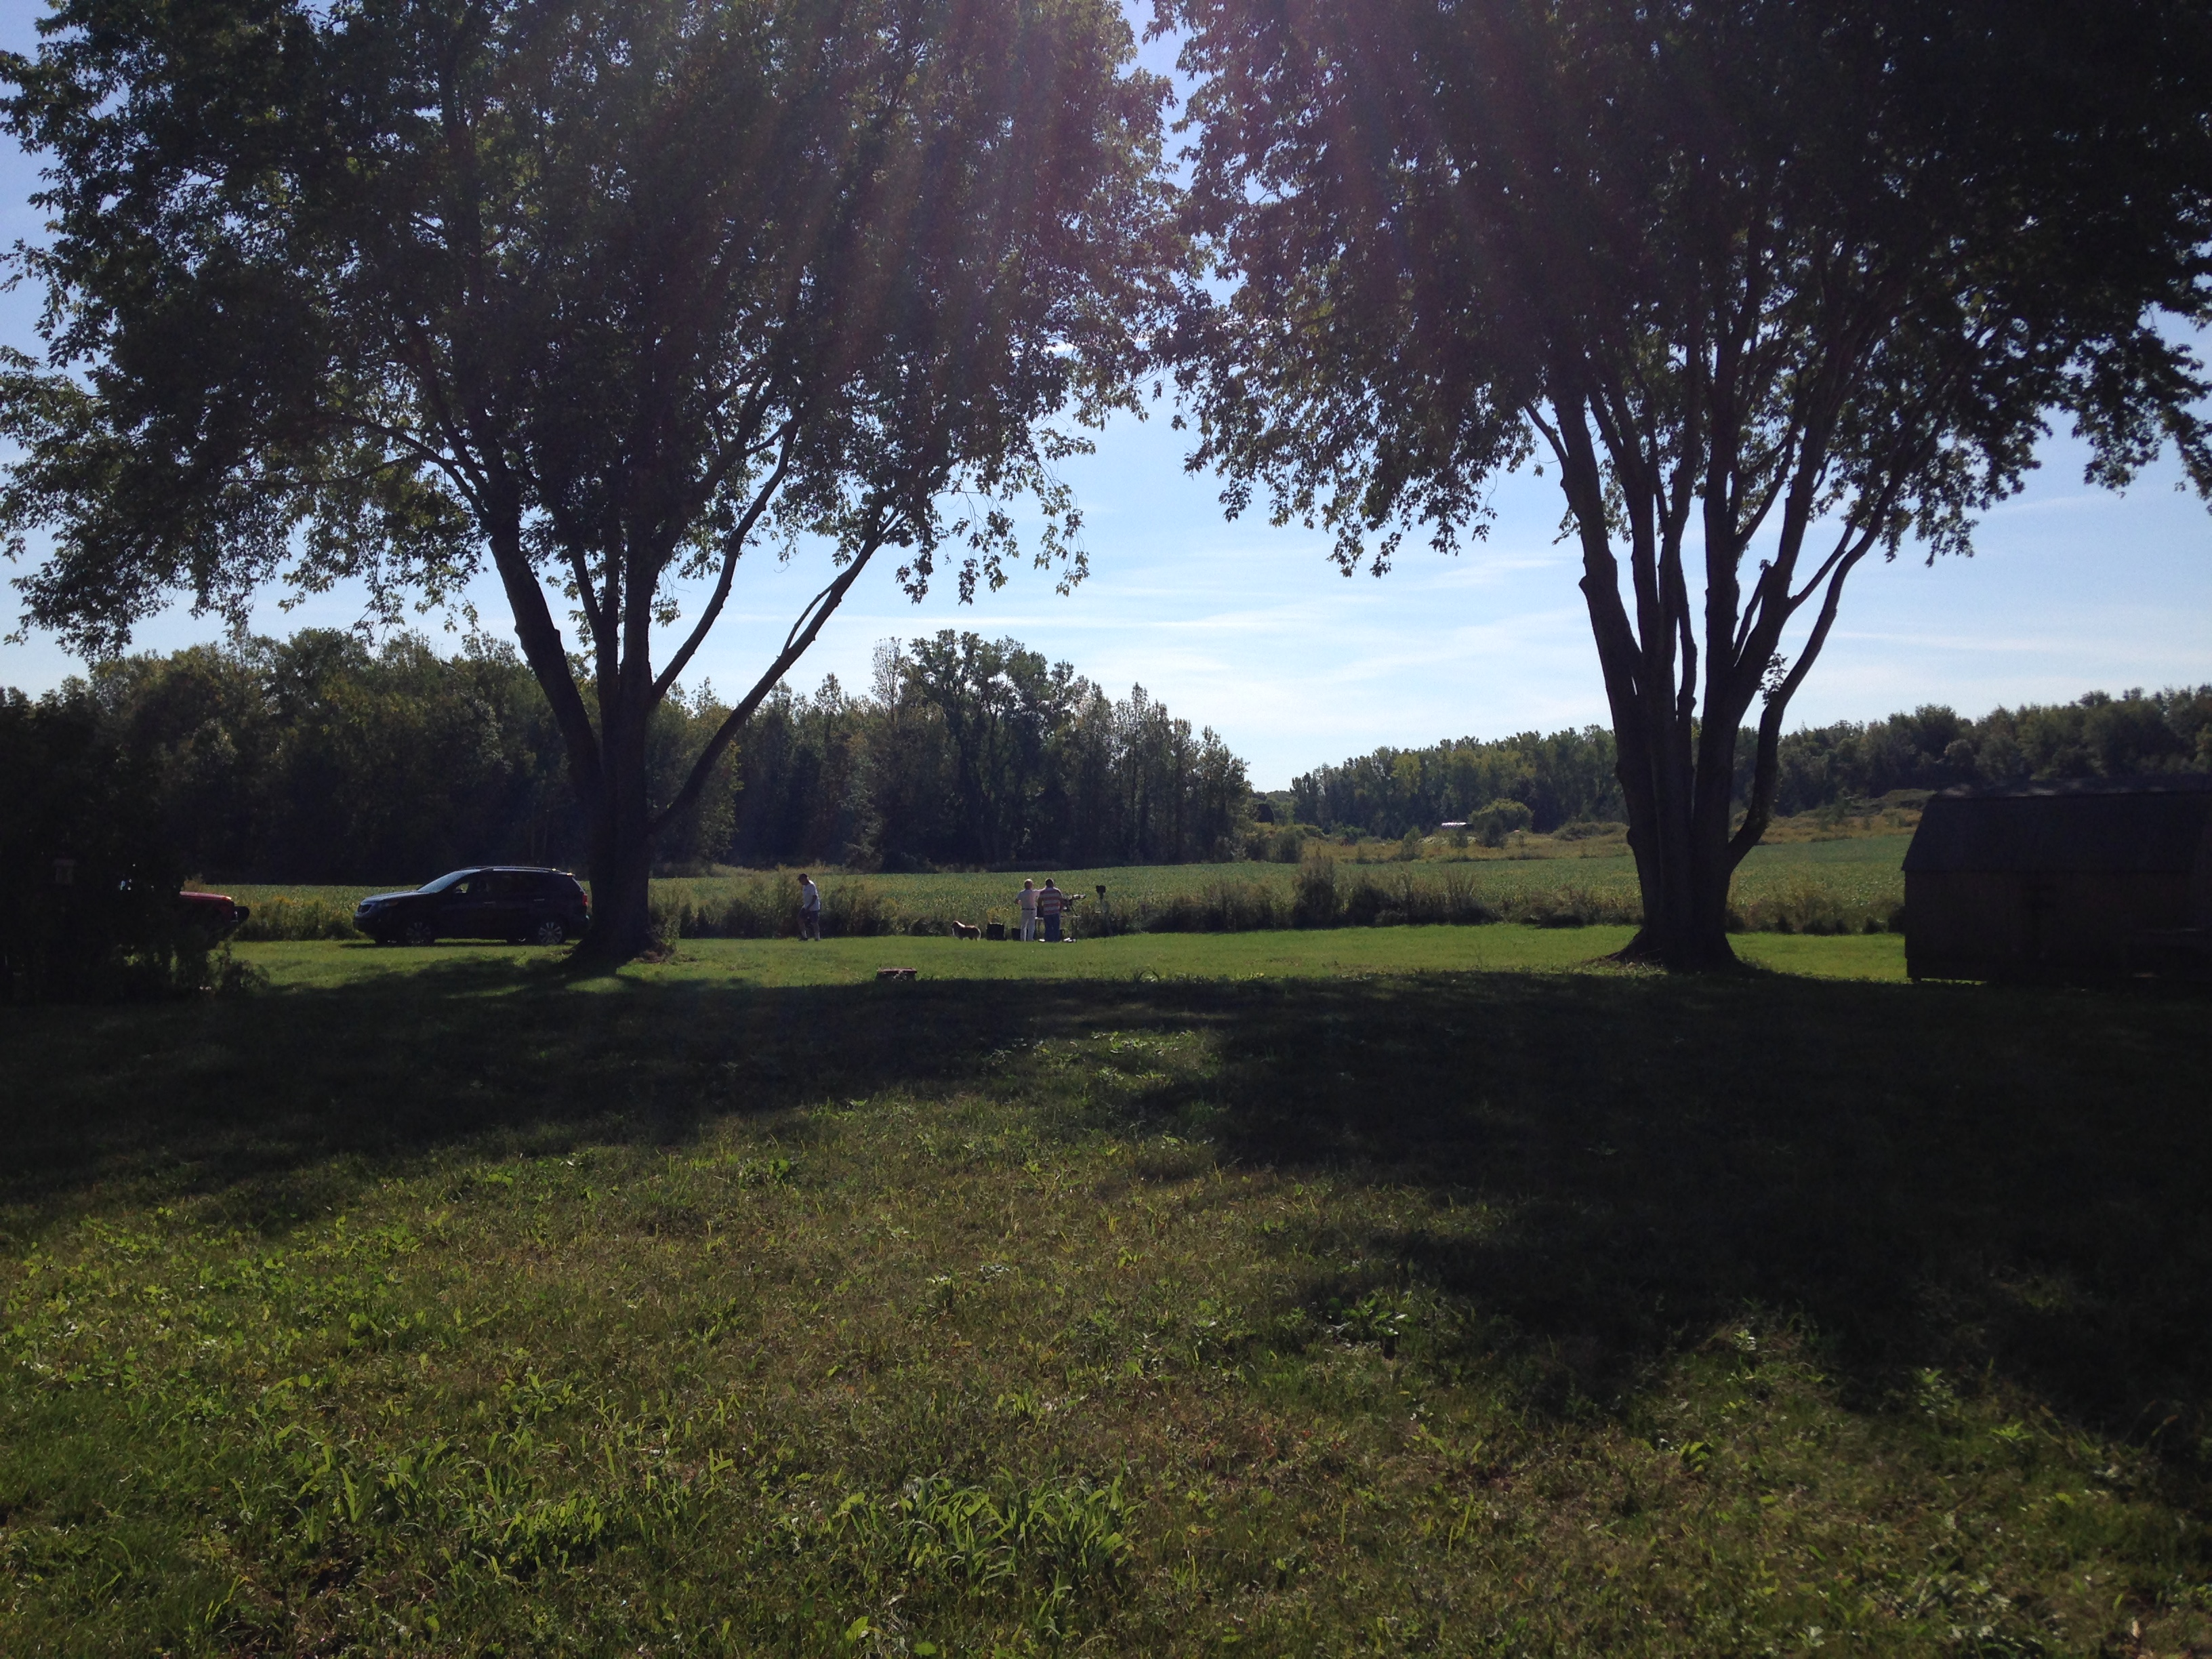
The Progress

Slide 30
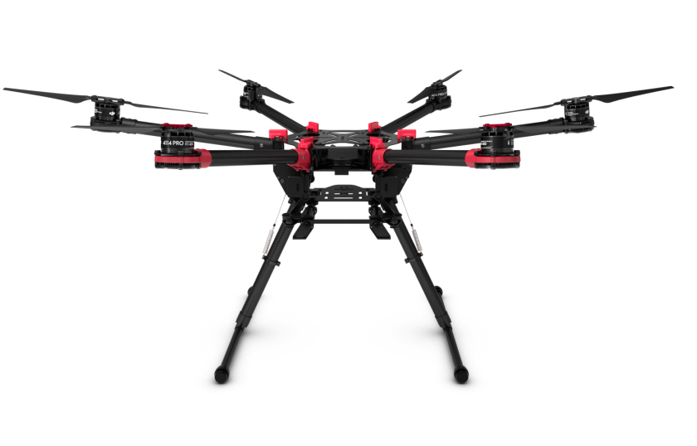
The Progress
Spreading Wings S900 drone
Max flight time: 22 minutes

Slide 31
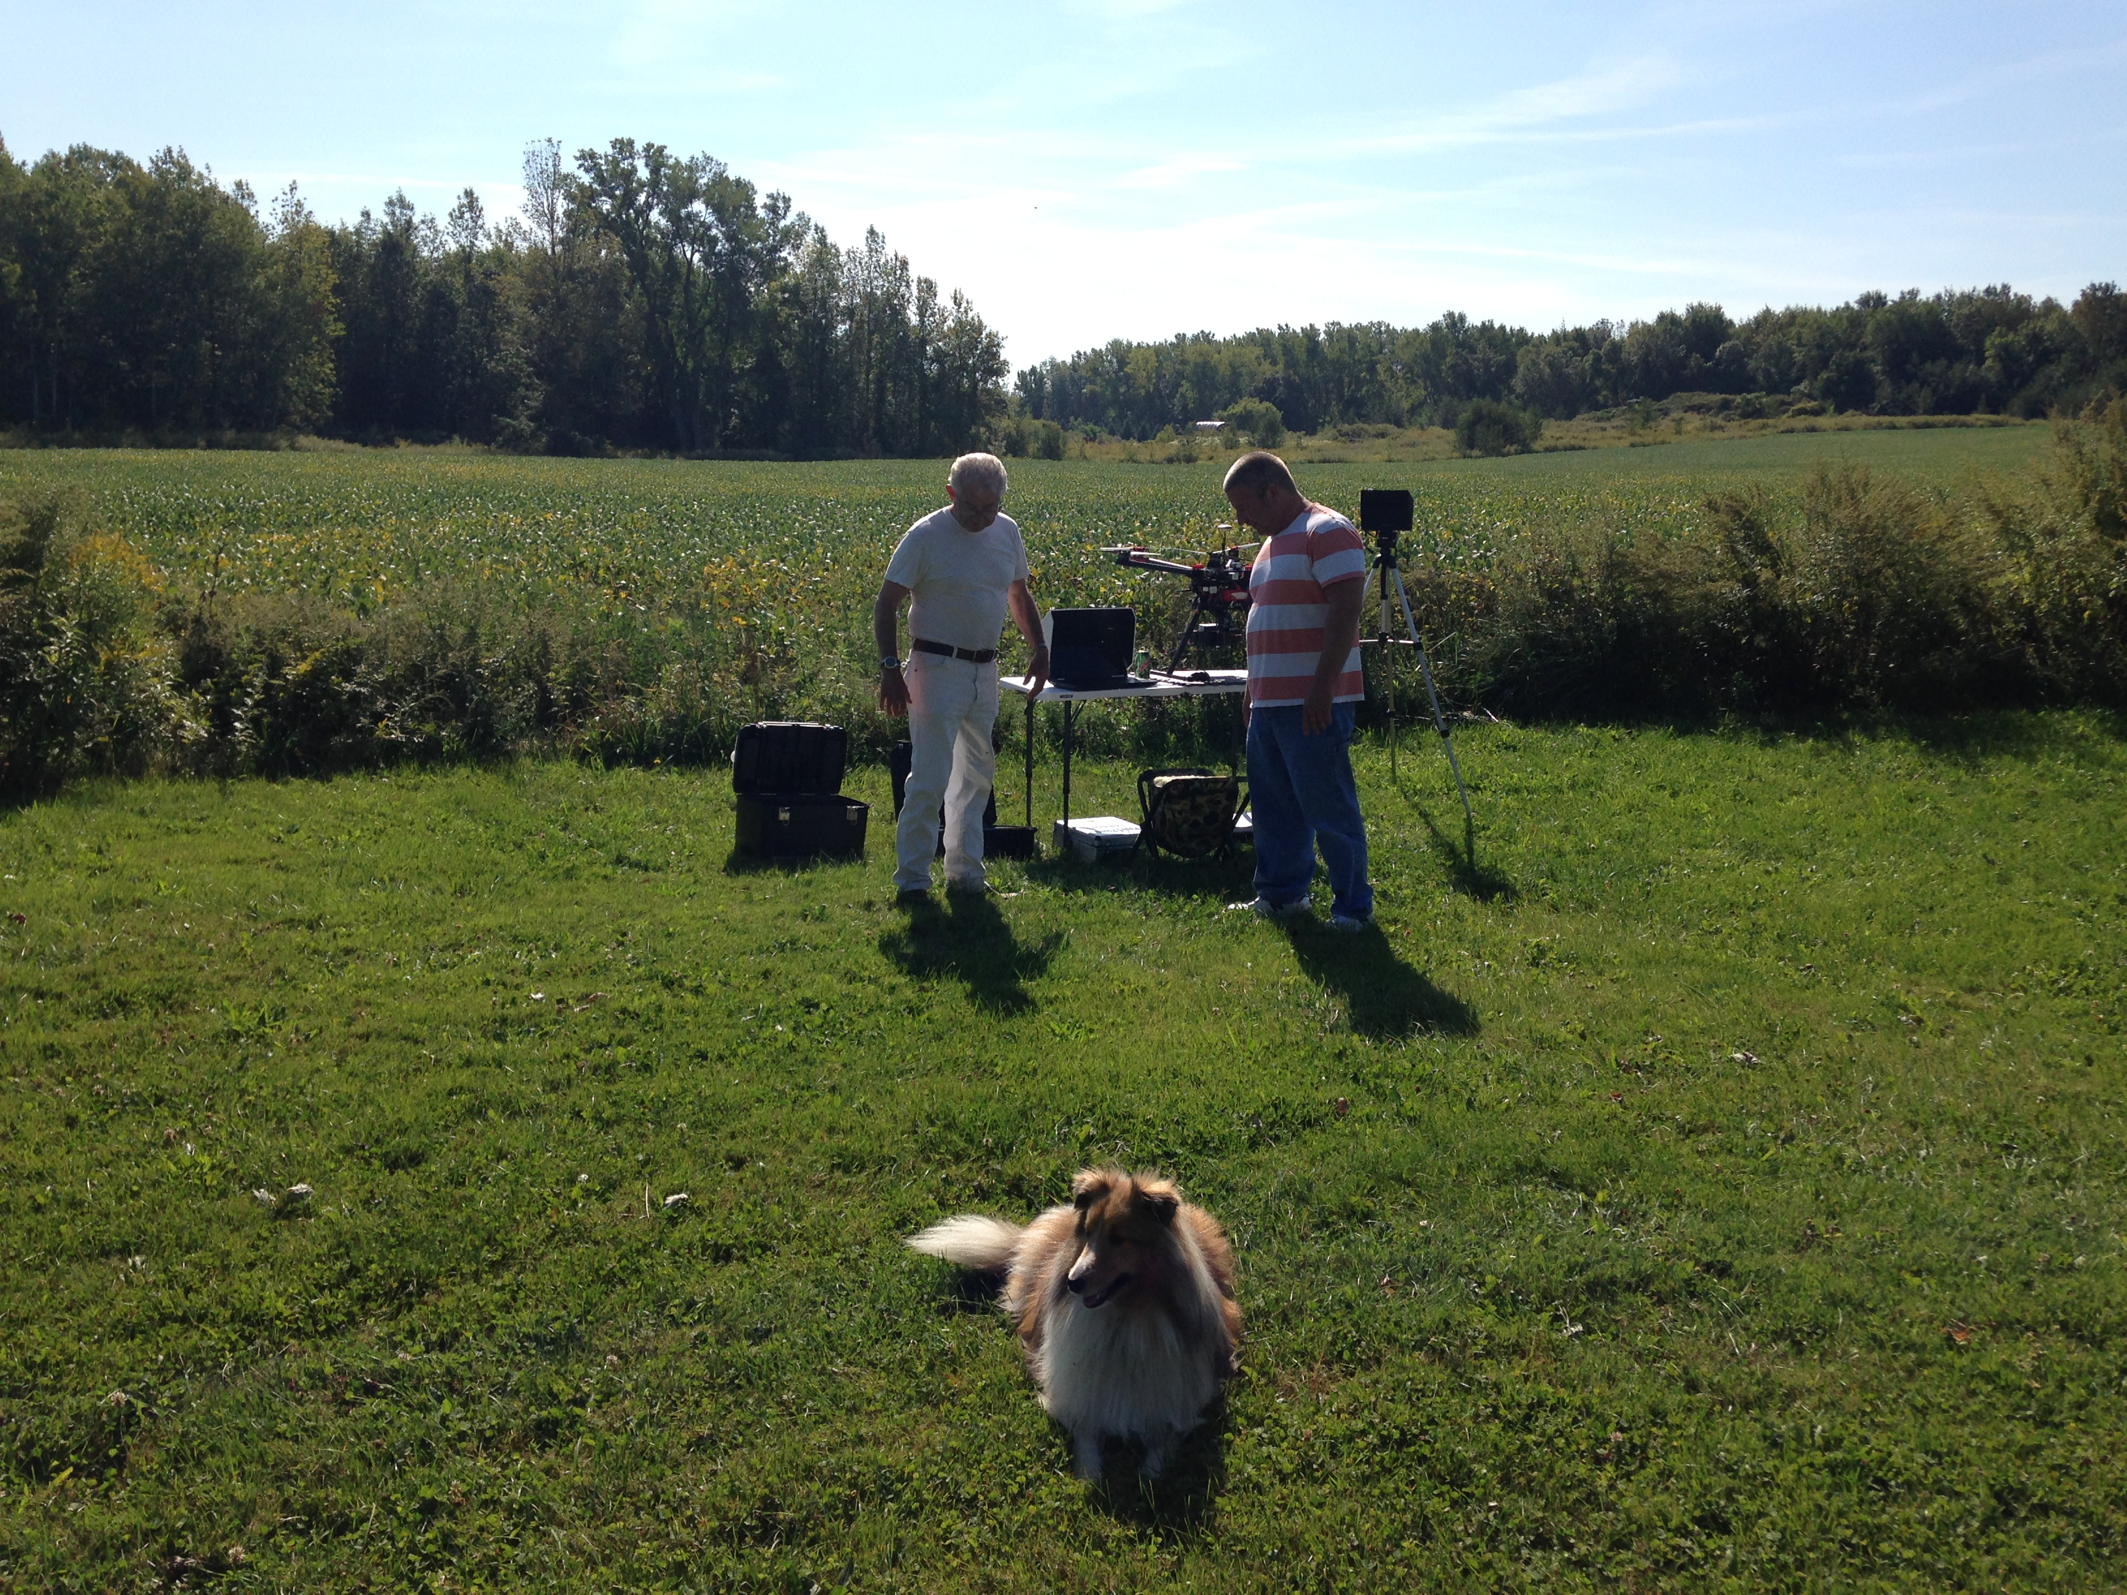
The Progress
Test Flight and Initial Aerial Capture

Slide 32
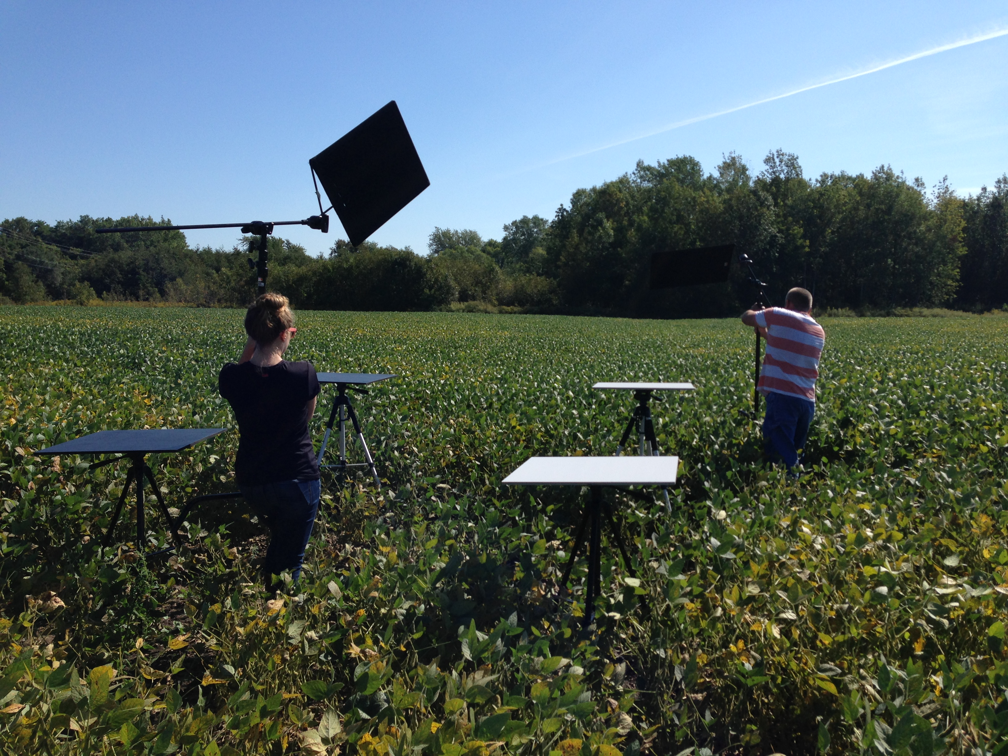
The Progress
Setting up Calibration Targets

Slide 33
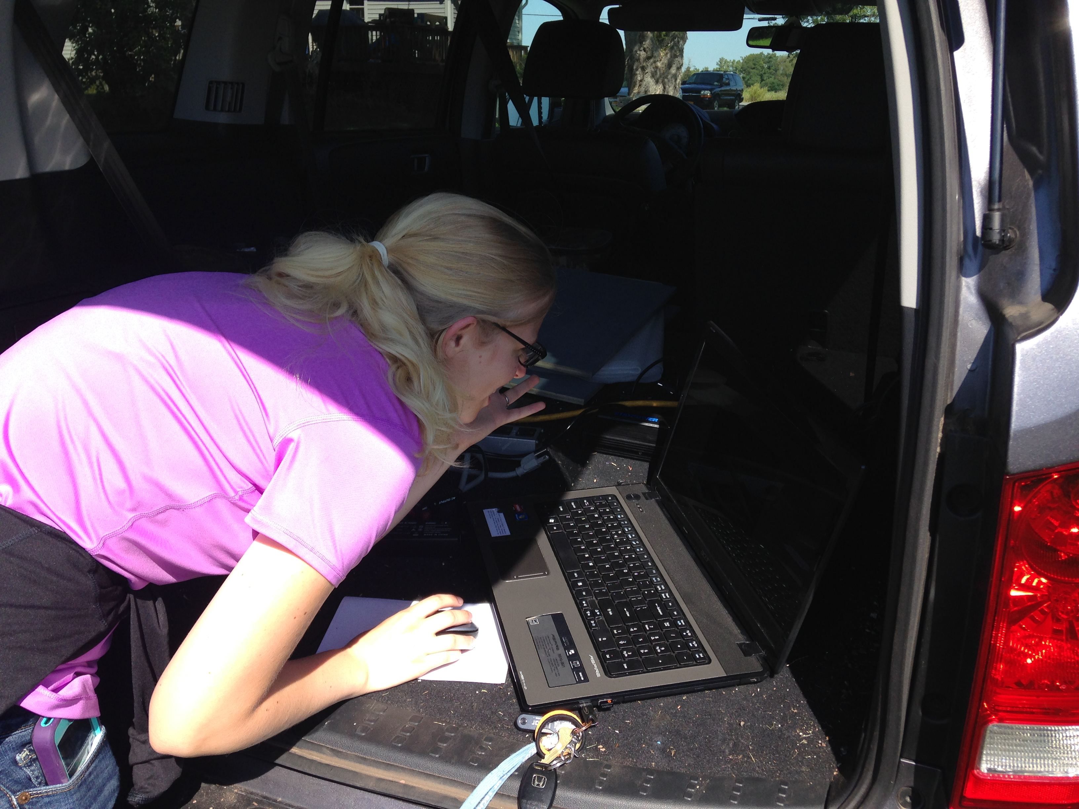
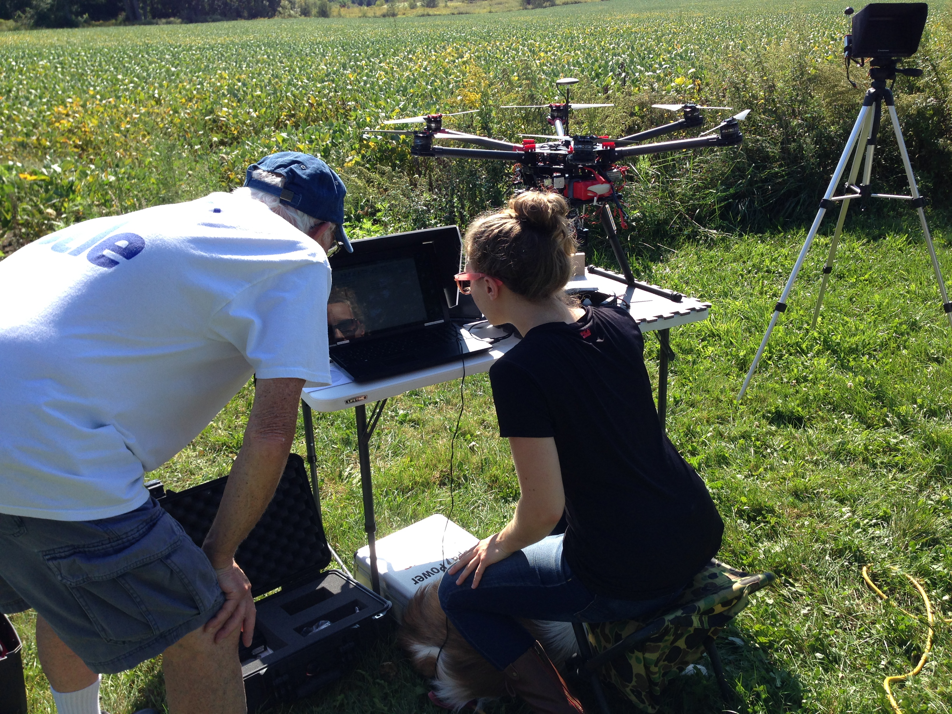
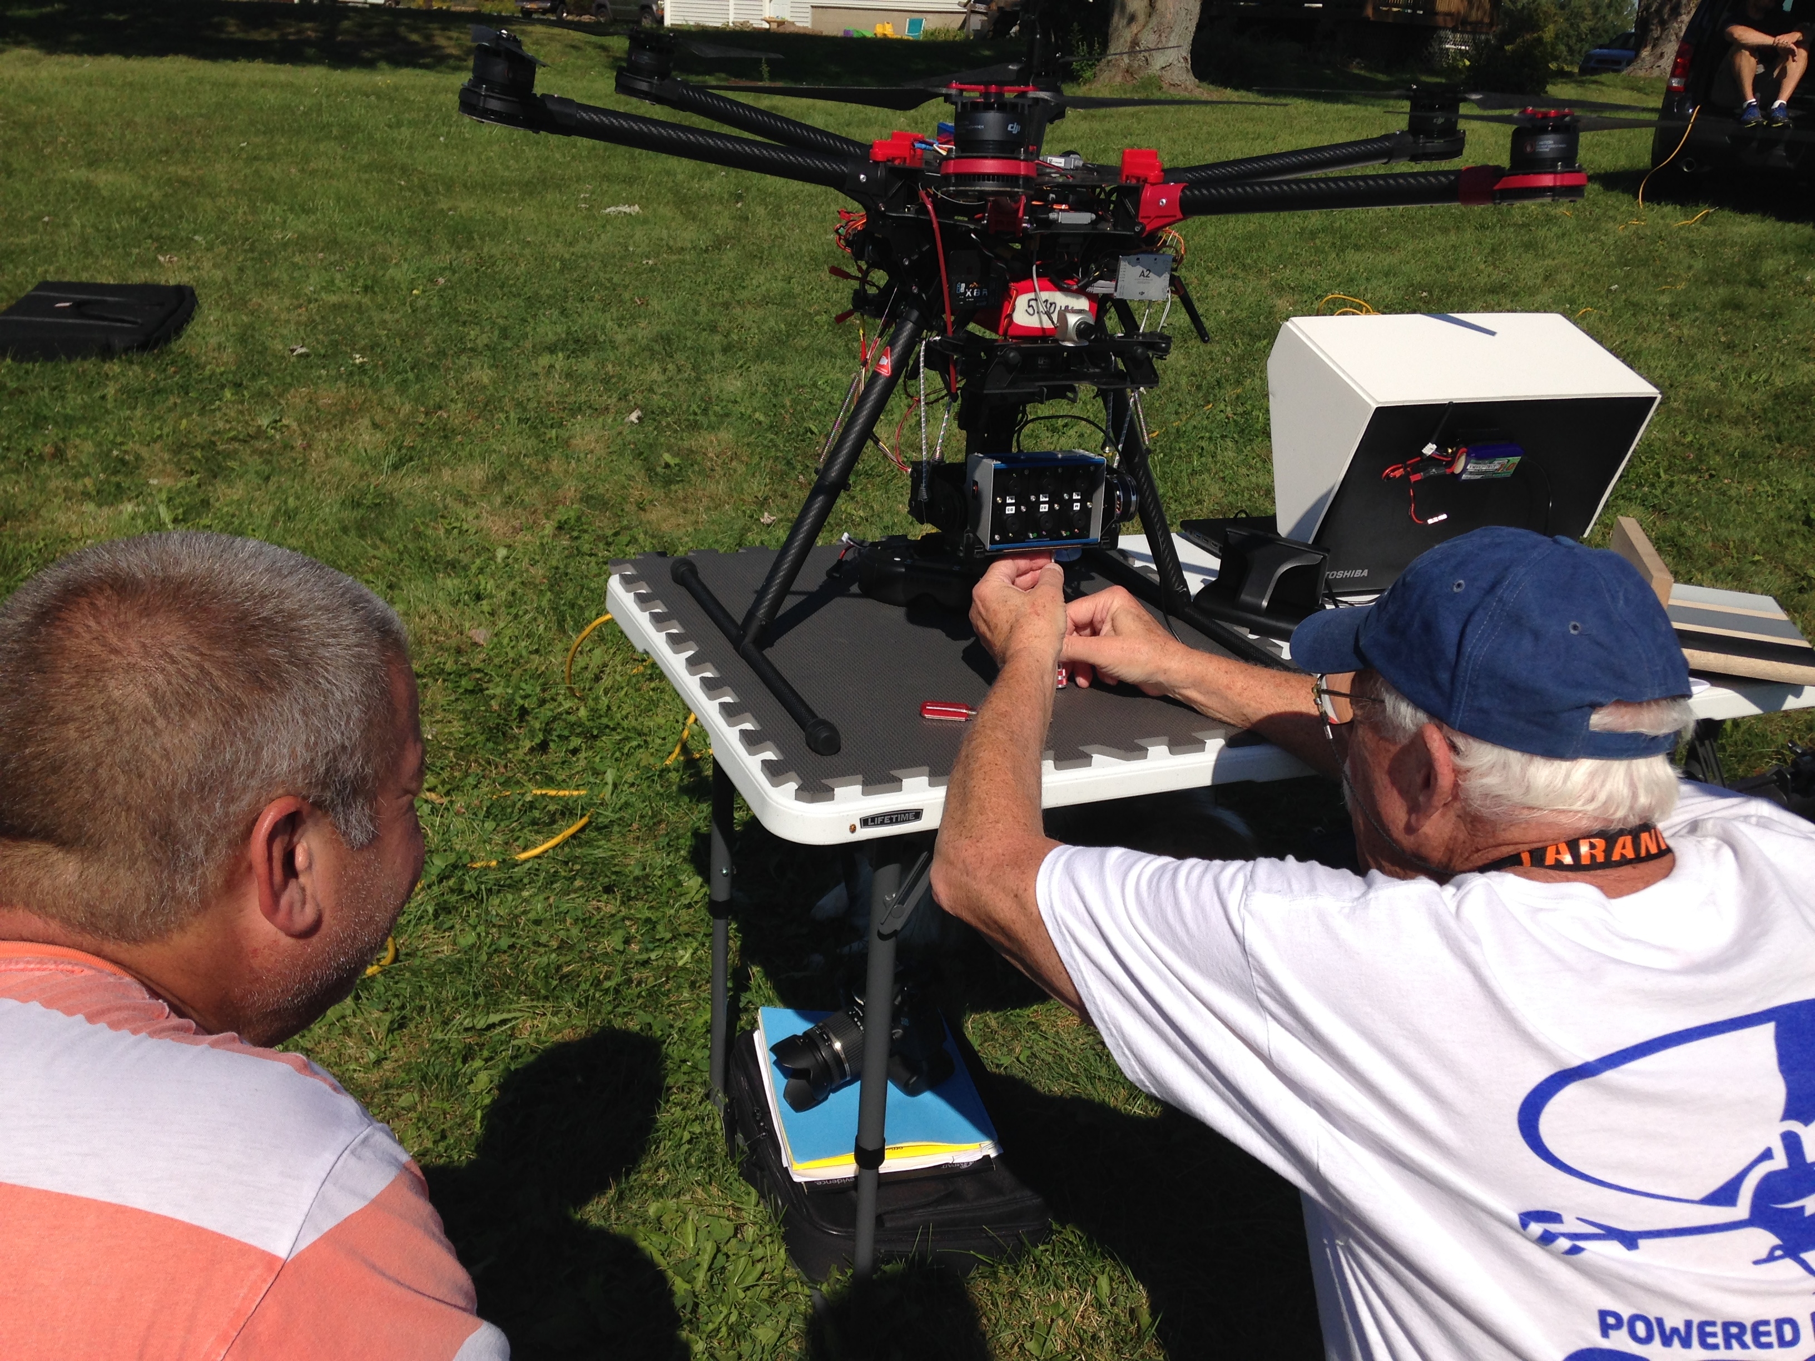
The Progress
Setting Exposure

Slide 34
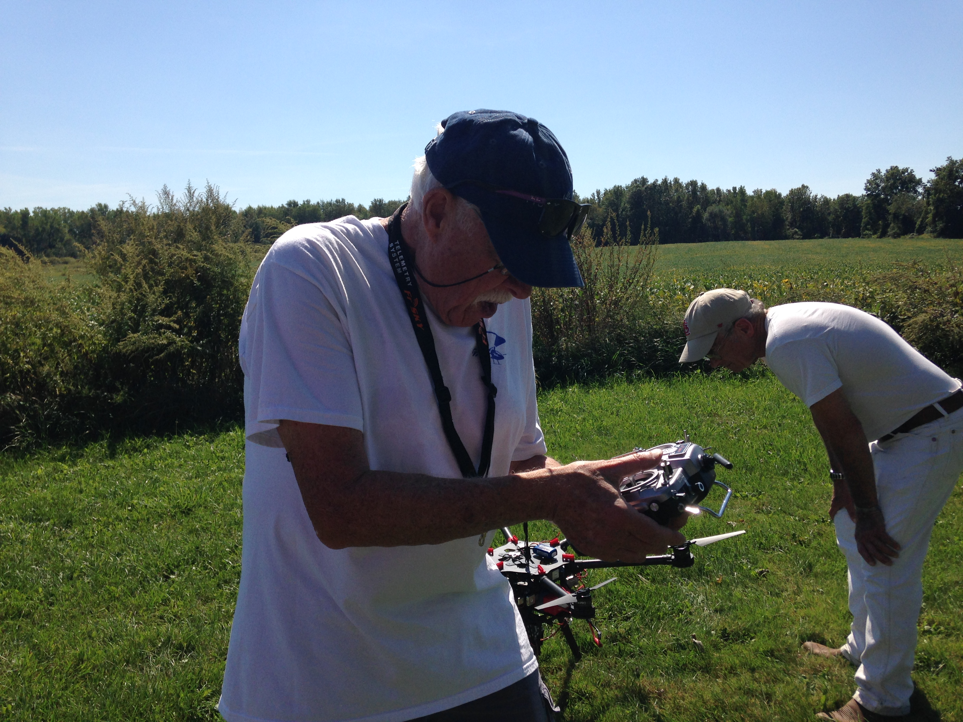
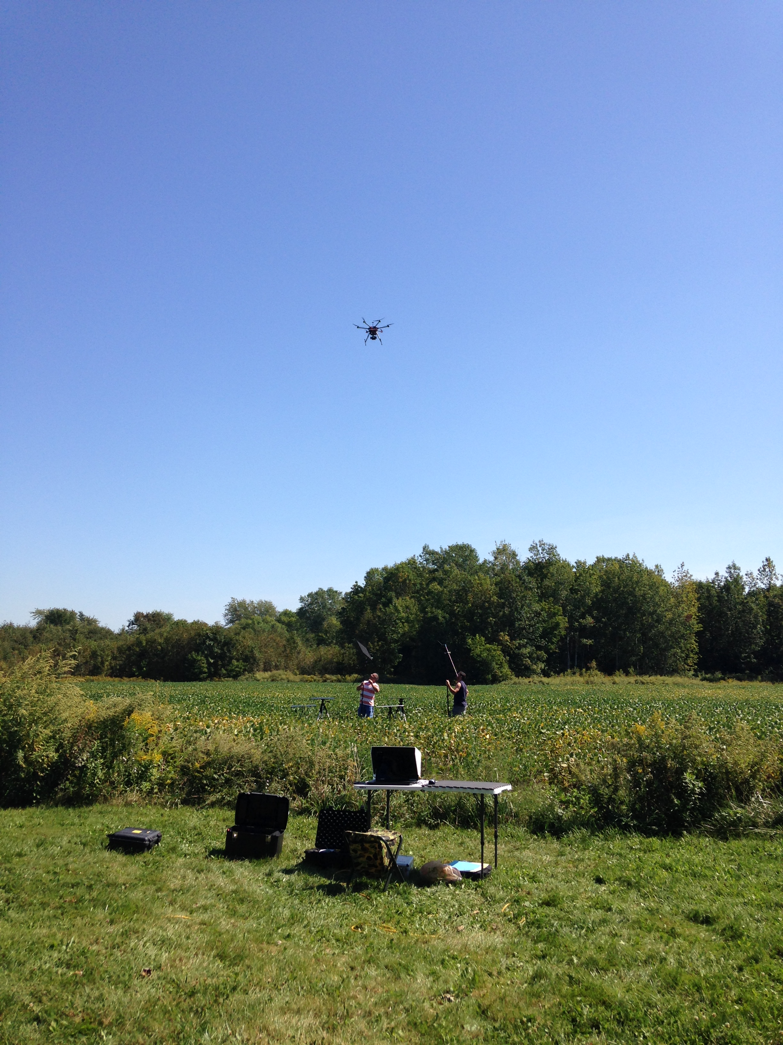
The Progress
Flight over Maier’s Farm Soybean Field

Slide 35
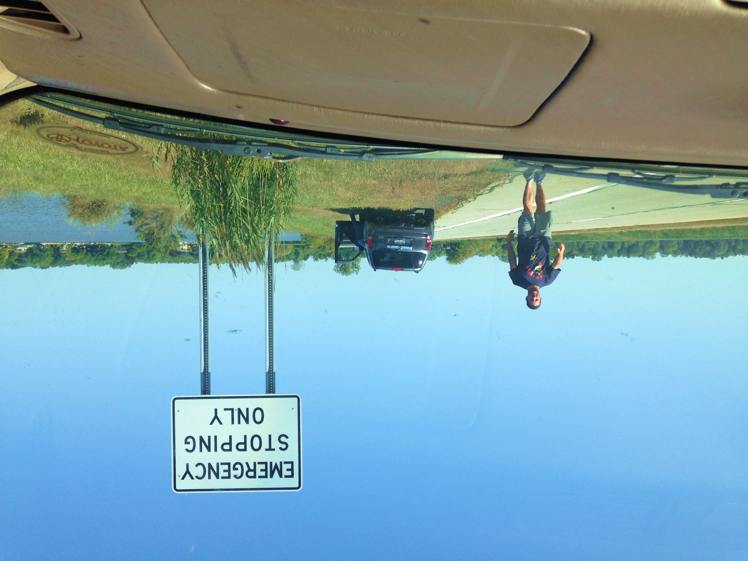
The Progress
Imaging Long Pond

Slide 36
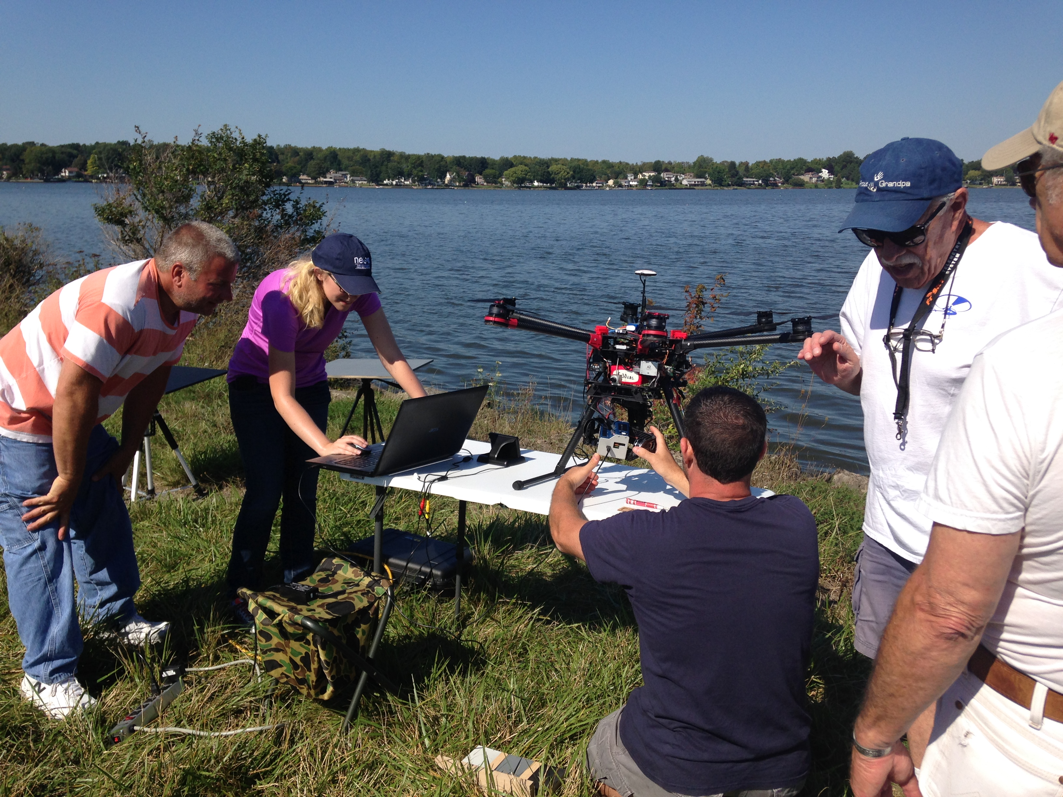
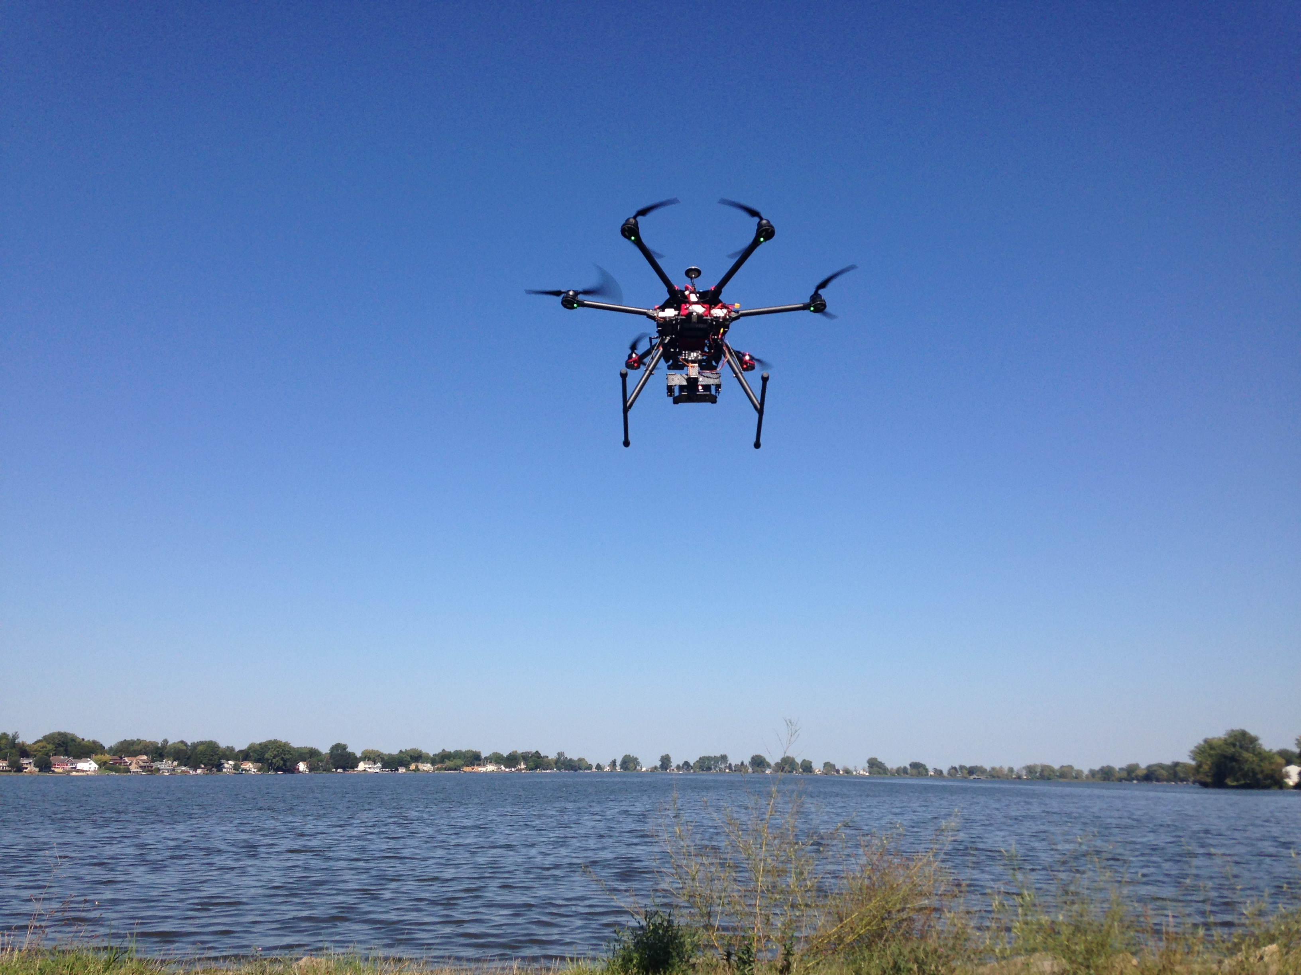
The Progress
Imaging Long Pond

Slide 37
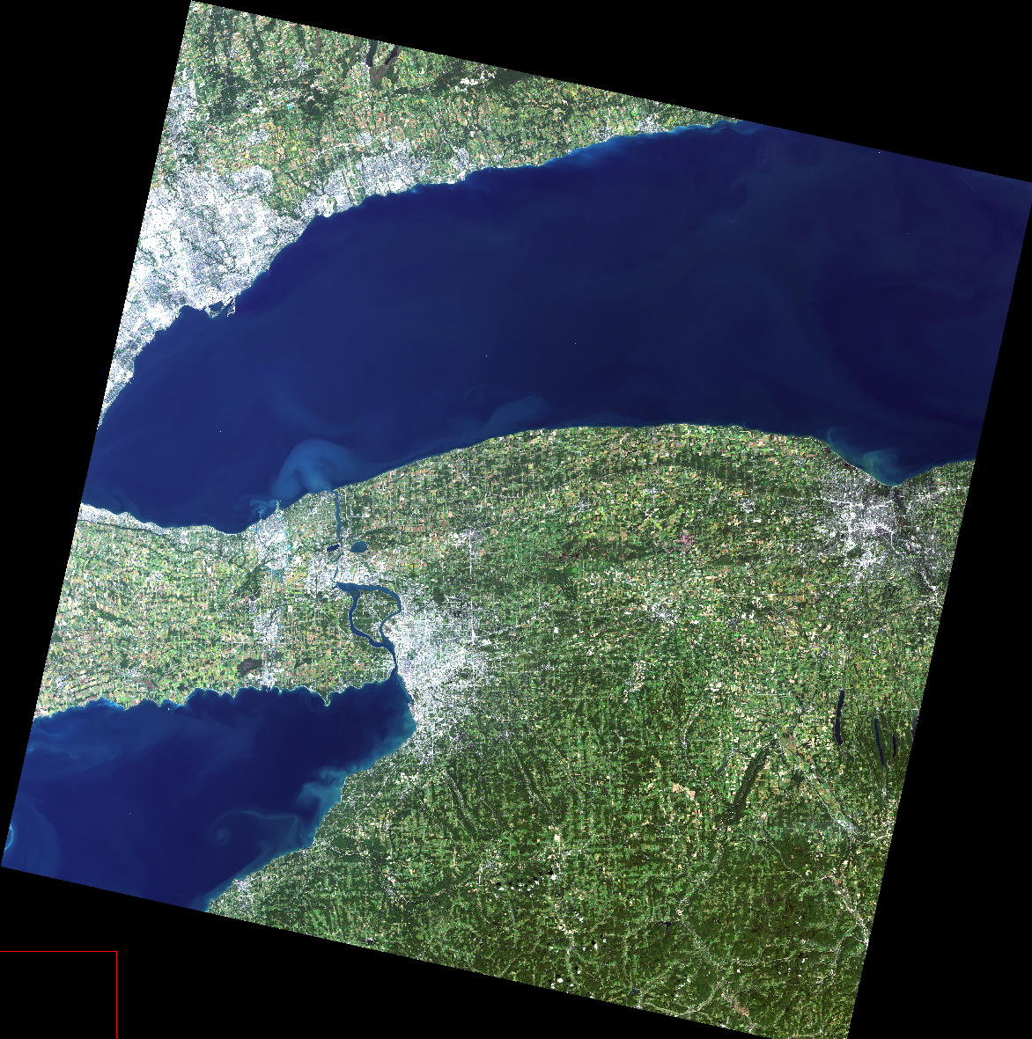
The Progress
Same-day Landsat collection, water samples taken

Slide 38
The Progress
Challenges in the field
Windows Updates
Efficient exposure method determined for vegetation
Inefficient exposure method determined for water
Manual flight renders imagery useless
No GPS information

Slide 39
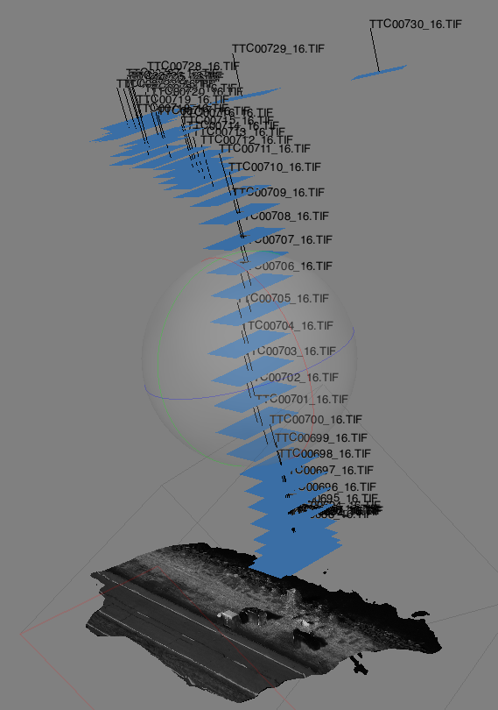
The Progress

Slide 40
The Future
Setting exposure for water scenes
Complications arise since the 800nm IR band is the master
Tetracam was designed for imaging vegetation
MODTRAN modeling in progress

Slide 41
The Future
Setting exposure for water scenes
Complications arise since the 800nm IR band is the master
Tetracam was designed for imaging vegetation
MODTRAN modeling in progress
Calibration
Make flags
Develop automated calibration routine
Feature recognition (targets)
Extract pixel values
Apply ELM
Test runs

Slide 42
The Future
Setting exposure for water scenes
Complications arise since the 800nm IR band is the master
Tetracam was designed for imaging vegetation
MODTRAN modeling in progress
Calibration
Make flags
Develop automated calibration routine
Feature recognition (targets)
Extract pixel values
Apply ELM
Test runs
Water quality analysis
Mosaic over water
Multispectral analysis

Slide 43
The Future
Anticipated to be involved in the following:
● Writing grant proposal for funding
● Modeling to determine spectral bands most pertinent to water quality analysis
● Acquisition and integration of hardware components
● Learning to operate UAS & program flight collection paths
● Ground truth data collection
● ELM Calibration to account for atmospheric effects
● Collaboration with other academic institutions for measurements
● Stitching together collected imagery
● Programming algorithms to extract water quality information from imagery
● Producing RGB and in-water constituent map for scene
KEY
Completed
In progress
Not yet attempted
Likely not going to be involved

Slide 44
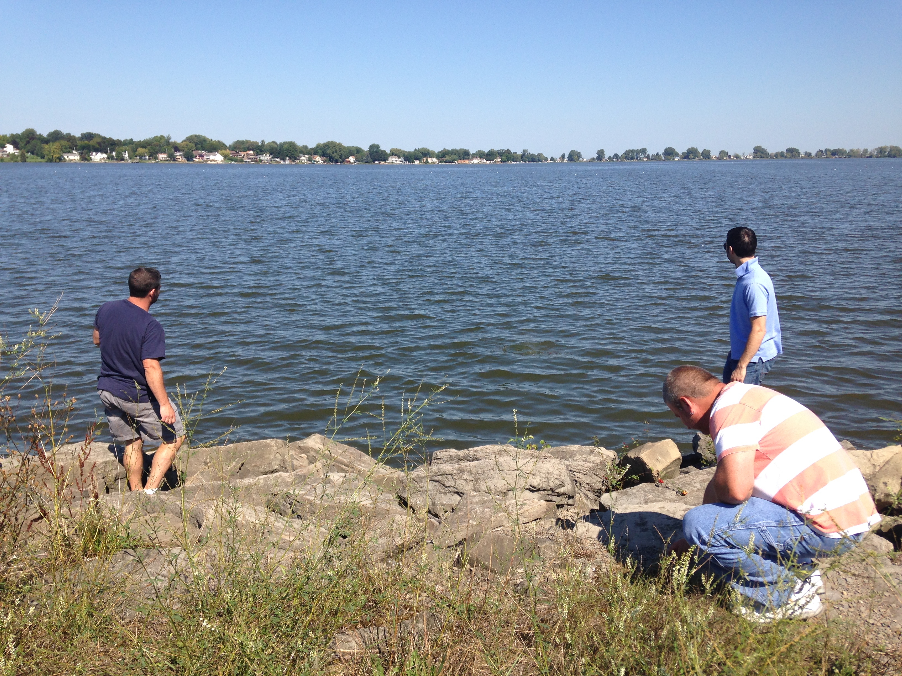
Questions / Comments?

